Slide 1

Data Abstraction for Vascular Surgery Procedures
Module IV in the VS Coordinator Training
Part 1: Open AAA and EVAR
Notes:
Welcome to Part One of Data Abstraction for Vascular Surgery Procedures training, covering Abdominal Aortic Aneurysm Repair Procedures, Open AAA and EVAR
This training module is intended for new VS coordinators and data abstractors, or anyone needs a refresher on vascular surgery procedures and accurate data abstraction.

Slide 2
BMC2 Vascular Surgery Procedures
Open Abdominal Aneurysm Repair (OAAA)
Endovascular Abdominal Aneurysm Repair (EVAR), Infrarenal, Suprarenal, and Juxtarenal Repairs
Open Bypass Procedures, Upper and Lower Extremity
Open Thrombectomy Procedures, Upper and Lower Extremity
Carotid Stenting (CAS)
Carotid Endarterectomy (CEA)
Notes:
We learned in an earlier module that BMC2 collects patient data on these six surgical procedures.
Part One of this module will cover the two procedures for abdominal aortic aneurysm repair : Open AAA repair and EVAR.

Slide 3
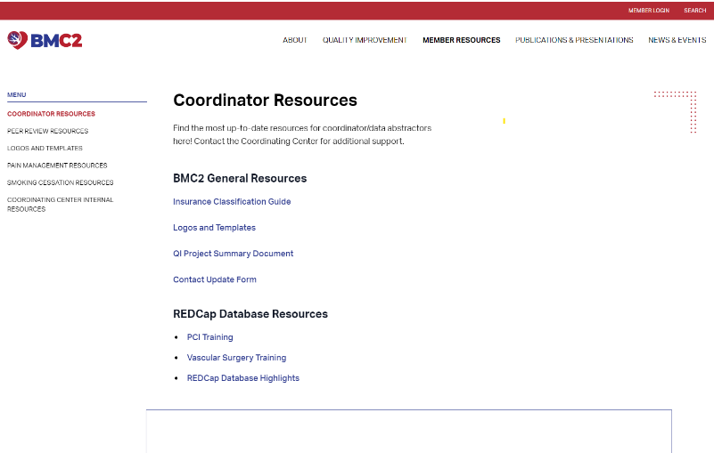
Data Abstraction Resources
Notes:
Before we start, please pause this video and navigate to the data abstraction resources on the BMC2 website that were introduced in the Coordinator Responsibilities module, and follow along using the VS Qualifying Case Criteria document, the EVAR and Open AAA worksheets, and the VS data dictionary.

Slide 4
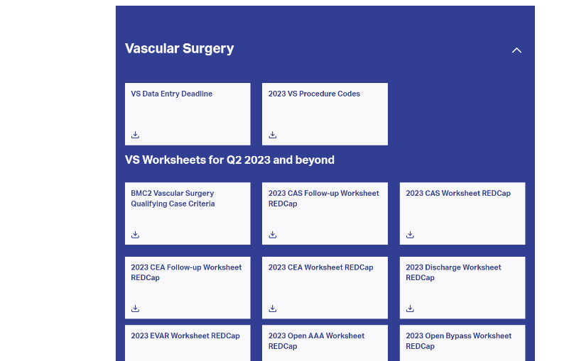
Data Abstraction Resources

Slide 5
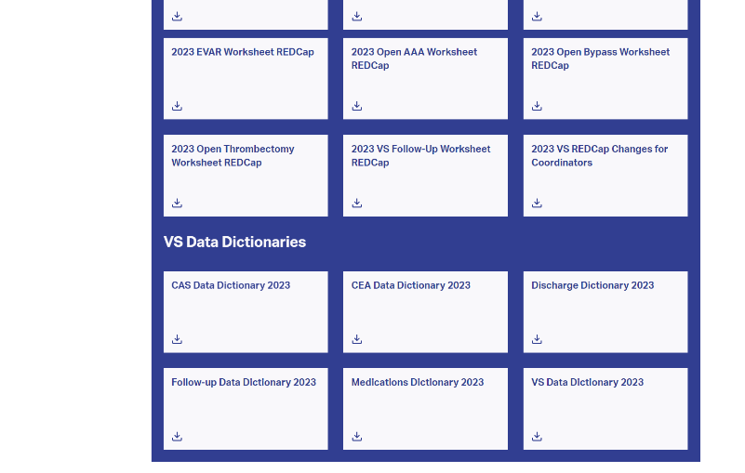
Data Abstraction Resources

Slide 6
AAA Repair Procedures:
OAAA & EVAR
AAA Anatomy | Procedure Overview

Slide 7
AAA Anatomy
Notes:
Let’s start by looking at the anatomy of the abdomen. AAA repair procedures that qualify for entry into the VS registry occur in the aorta, below the diaphragm.

Slide 8
AAA Anatomy
Notes:
In addition to the location of these qualifying procedures, it’s important to understand the differences in aneurysm location regarding the renal arteries.
Starting on the left, Infrarenal means below the renal arteries, next there is Juxtarenal, meaning at the renal arteries, and suprarenal means the aneurysm is situated above renal arteries and below the diaphragm..

Slide 9




Indications for AAA Repair
0.5 – 1 cm
1 year of monitoring
5.5 cm (55 mm)
5.0 cm (50 mm)
Chaikof, E.L. et al. (2018) ‘The Society for Vascular Surgery Practice Guidelines on the care of patients with an abdominal aortic aneurysm’, J. Vasc. Surg, 67(1). doi:10.1016/j.jvs.2017.10.044.
Notes:
Now let’s review the Indications for an AAA repair. In medicine, an indication means a valid or appropriate reason to use that specific procedure or surgery. The society of vascular surgery (SVS) has guidelines for appropriateness of AAA repair based on size of the aneurysm upon discovery and on surveillance.
The indications guidelines state that an abdominal aortic aneurysm must be at least 5.5 cm (55 mm) for men and 5 cm (50 mm) for women or increasing in size by 0.5 cm to 1 cm in 6 months to a year.
The patient must have at least two CTs to compare and confirm the aneurysm is rapidly increasing.

Slide 10
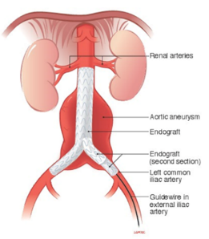
AAA Procedure Overview
OAAA
Goal: Remove aneurysm
Major surgery
Longer recovery
Risk of adverse outcomes
Definitive fix
EVAR
Goal: To prevent enlargement and rupture
Minimally invasive
Shorter hospital stay
Lifelong imaging surveillance
Notes:
There are two procedures to repair an Abdominal Aortic Aneurysm: Open AAA and EVAR. Each procedure is very different, has different risks and different goals.
An Open AAA is an invasive surgical procedure requiring an incision in the abdomen. It’s major surgery, involves more risk, requires a longer recovery, however the goal is a definitive fix.
On the other hand, an EVAR procedure is endovascular, minimally invasive, and allows for a shorter length of stay. The goal of an EVAR is to prevent aneurysm enlargement and will require lifelong surveillance.

Slide 11
Open Abdominal Aortic Aneurysm (OAAA)
Qualifying Case Criteria | Procedure Data Fields

Slide 12
Open AAA Repair Video
Open AAA Repair Video
Note: This video is for educational purposes only
Notes:
To better understand the Open AAA procedure, please pause and watch the video above.

Slide 13
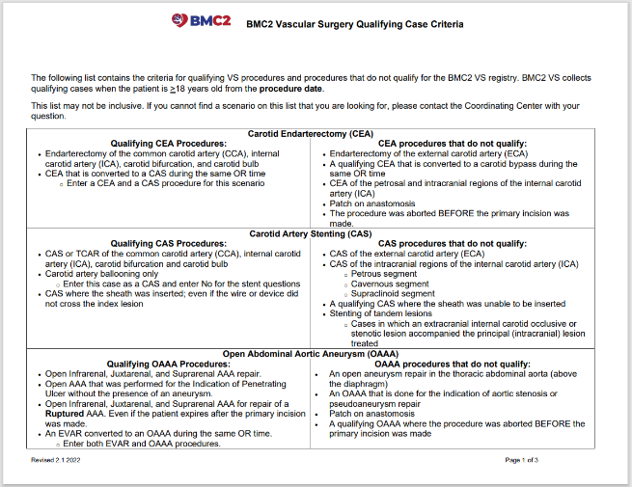
OAAA Qualifying Case Criteria
Notes:
We learned earlier about the indications, which refer to the appropriateness of AAA repair procedures, however, Meeting the criteria for appropriateness doesn’t necessarily mean that procedure is to be included in the BMC2 VS data registry. Let’s look at the BMC2 Vascular Surgery Open AAA Qualifying Case Criteria document to get a better sense of the qualifying criteria.

Slide 14
OAAA Qualifying Case Criteria
Qualifying Criteria: Open Infrarenal, Juxtarenal, and Suprarenal AAA repair
Notes:
The first of the qualifying criteria is that the procedure is done for Open Infrarenal, Juxtarenal, and Suprarenal AAA repair, meaning the aneurysms below the diaphragm and either below, at or slightly above the renal arteries.

Slide 15
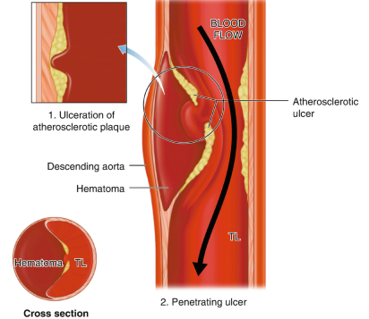
OAAA Qualifying Case Criteria
Qualifying Criteria: Open AAA that was performed for the Indication of Penetrating Ulcer without the presence of an aneurysm
Notes:
The second qualifying criteria is that the procedure was performed for the Indication of Penetrating Ulcer without the presence of an aneurysm
A penetrating ulcer is an irregularity of the aortic wall caused by the formation of plaque from atherosclerosis. The plaque wears down the inner lining of the aorta, which can lead to a rupture. Because of the risk of rupture, we treat a penetrating ulcer with OAAA repair.

Slide 16
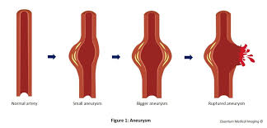
OAAA Qualifying Case Criteria
Qualifying Criteria: Open Infrarenal, Juxtarenal, and Suprarenal AAA for repair of a Ruptured AAA
Ruptured AAA must have evidence of…
Extravasation on pre-procedure imaging
Rupture on arrival to the OR
Not to be confused with a CONTAINED RUPTURE!
Notes:
The third qualifying criteria is the qualifying repair is done on a Ruptured AAA
A ruptured AAA is an emergent situation and must be diagnosed and fixed as quickly as possible. A ruptured AAA will must have evidence of extravasation on pre-procedure imaging or a rupture upon arrival to the OR

Slide 17
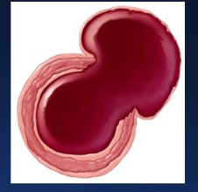
OAAA Qualifying Case Criteria
Contained Rupture
No contrast extravasation
Outpouching of the aorta
Hematoma seals the retroperitoneum
Notes:
A ruptured AAA must not be confused with a contained rupture. In a contained rupture of an aneurysm, the extravasation of blood is limited or restricted by surrounding tissues, forming a contained hematoma. This means that the weakened wall of the aneurysm has ruptured showing an outpouching of the aorta, but the bleeding is confined within a space created by adjacent structures, such as the surrounding tissues or organs in the retroperitoneum.
Contained ruptures can wait a longer period for repair while they are monitored for an increase in its size.

Slide 18

OAAA Qualifying Case Criteria
Qualifying Criteria: An EVAR converted to an OAAA during the same OR time
EVAR
OAAA
Notes:
The fourth qualifying criteria is An EVAR converted to an OAAA during the same OR time
You may find cases that were started as an EVAR but for certain reasons were converted to an Open AAA during the same OR time. In terms of data abstraction, both cases could be entered as individual procedures – as an EVAR as well as an Open AAA.

Slide 19
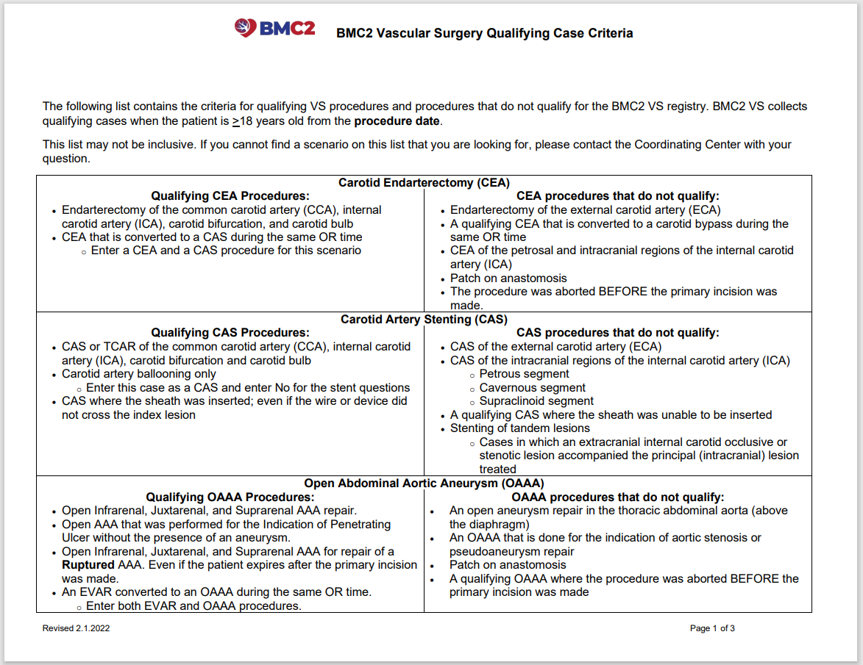
Notes:
Now let’s take a quick look at the criteria for procedures that do not qualify.
The first disqualifying criteria is if the repair procedure was done in a section of the aorta above the diaphragm. The second disqualifying criteria is referring to procedures that do not match the indication specified in this training: aortic stenosis is a narrowing of the aorta and a pseudoaneurysm is not a true aneurysm, so they are disqualified. The third disqualifying criteria is an Open AAA to patch anastomosis, which is an important surgical procedure, but not one we collect in the vascular surgery database. Finally, the fourth disqualifying criteria when a procedure was aborted before the primary incision was made.

Slide 20
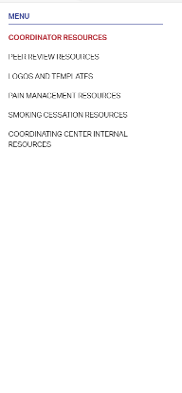
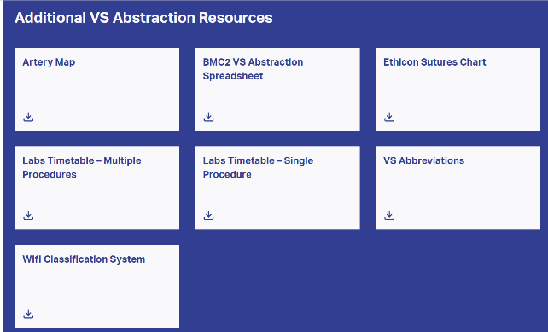
Data Abstraction
Notes:
Just as a reminder, you can download the VS Abstraction Spreadsheet template from the BMC2 website, which will help you keep track of the qualifying procedures at your site. For a refresher on using this template, you may revisit Part 1 of the Coordinator responsibilities and expectations module.

Slide 21
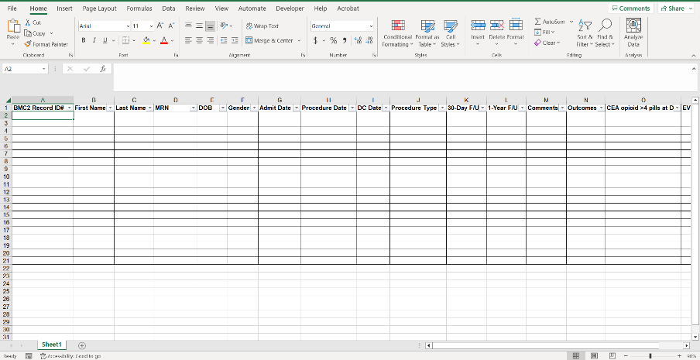
Data Abstraction

Slide 22
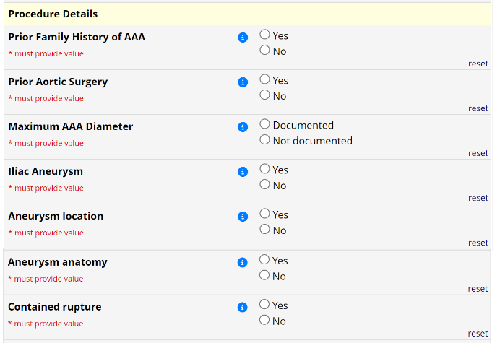
Procedure Data Fields: Open AAA
Notes:
In this section of the training, we are going to cover important clinical details for the following data variables:
Contained Rupture
Ruptured AAA
Exposure
Distal anastomosis
Renal status
Proximal clamp position
Renal visceral ischemic time
Cold renal perfusion

Slide 23
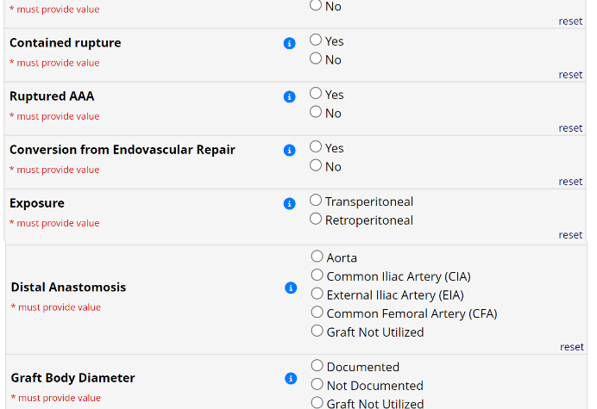
Procedure Data Fields: Open AAA
Notes:
Let’s start with contained rupture and ruptured AAA

Slide 24
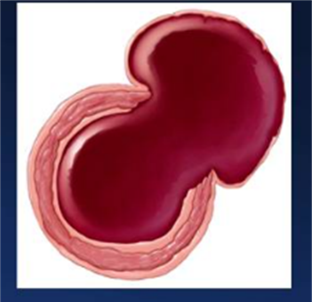
Procedure Data Fields: Open AAA
Contained Rupture
Ruptured AAA
Notes:
If you recall, a contained rupture and a ruptured AAA are different, and must be entered into the database accurately.
A contained rupture’s bleeding is contained by surrounding tissues and does not require immediate surgical repair. So, for contained ruptures, you would select Yes.
However, if there is evidence of a rupture in pre-operative imaging or a rupture upon arrival to OR, you would select No to Contained Rupture and Yes to Ruptured AAA.
Rupture and contained rupture can be found in the pre-procedure imaging (CTA, MRA, or US) report or the op note. If the imaging report is not definitive, the abstractor may need to compare the surgeon's op note to the imaging report.

Slide 25
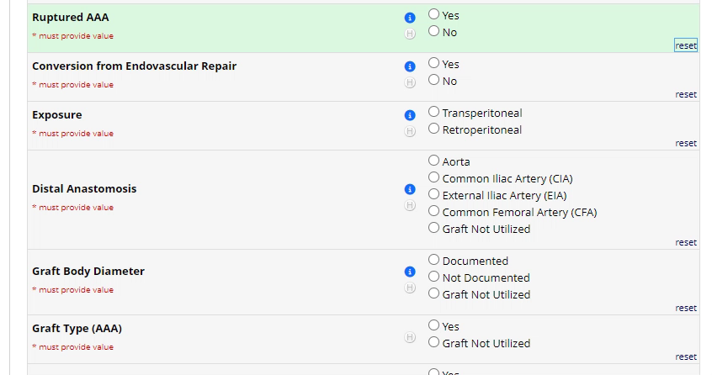
Procedure Data Fields: Open AAA
Notes:
If the patient had a Ruptured AAA, there are several data fields that appear when you click Yes. Let’s quickly cover what those additional data fields mean and how you answer them.

Slide 26
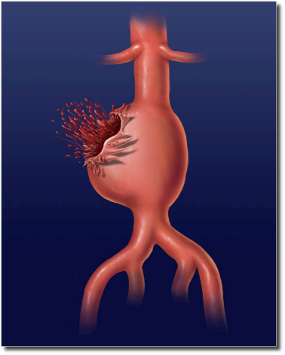
Ruptured AAA
Ruptured AAA
Lowest Pre-Intubation Blood Pressure
Mental Status
Cardiac Arrest
Notes:
For Lowest Pre-Intubation Blood Pressure, Enter the lowest systolic blood pressure taken after arrival to the hospital. If the patient was intubated before arriving to the hospital – enter Not documented.
For Mental Status, Enter the patient’s mental status upon arrival to the OR. If the patient is intubated when they get to the OR, enter Unconscious.
For Cardiac Arrest, Indicate if the patient was in cardiac arrest when they arrived to the OR.

Slide 27
Ruptured AAA
Ruptured AAA
Timeframe: Symptoms to Incision
Timeframe: Admission to Incision
Notes:
For Timeframe: Symptoms to Incision, Record the time from the patients first symptoms until the surgical incision in hours. The time of symptom onset may be documented in the EMS records, ED records or operative notes. If the time of symptoms onset is not exact, calculate the time as best you can. For example, if the symptom onset is documented as “two days ago” enter 48 hours. If the patient arrived to the hospital via EMS and time of symptom onset is not documented in the hospital documents, calculate the time of symptom onset from the time EMS made contact with the patient. You can find this information on the run sheet.
For Timeframe: Admission to Incision, Record the time from when the patient was admitted to the surgical incision in hours. If the patient was admitted through the ED, use the date and time the patient arrived to the ED. The date and time the patient arrived to the ED may be found in the nurse triage documents.

Slide 28
Procedure Data Fields: Open AAA

Slide 29
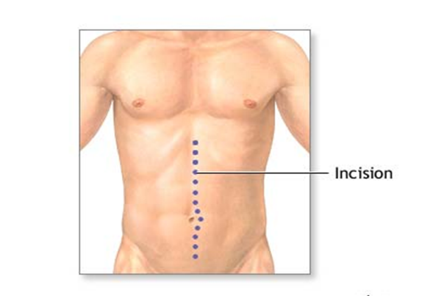
Procedure Data Fields: Open AAA
Exposure
Transperitoneal
Patient positioned on back
Midline incision
Greater incidence of ileus due to manipulation of bowel
Notes:
There are two options for the Exposure data field for an open AAA repair, Transperitoneal and Retroperitoneal. Let’s learn what they mean.
Transperitoneal, or transabdominal, is an incision through the peritoneum with the Patient positioned supine, or on their back facing upward.
There will be a midline incision that goes through the abdomen to the retroperitoneal space, moving bowel aside which can lead to an ileus post-procedure.

Slide 30
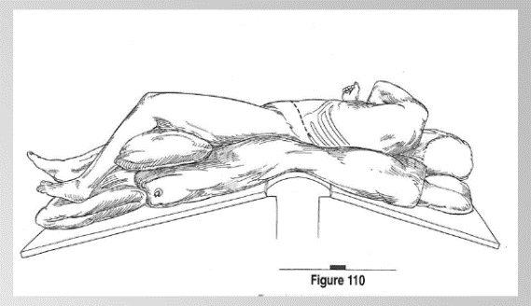
Procedure Data Fields: Open AAA
Exposure
Retroperitoneal
Patient positioned on side
Avoids manipulation of abdominal contents
Relieves pressure for patients with severe lung issues
Notes:
Another option for exposure data field is retro peri Retroperitoneal.
Retroperitoneal exposure enters the abdomen from behind the peritoneum with the Patient positioned laterally, or on their side, sometimes referred to as “sloppy lateral”
This position avoids manipulation of abdominal contents and relieves pressure for patients with severe lung issues, and may be used for patients who have had abdominal surgeries in the past, to avoid having to deal with adhesions.

Slide 31
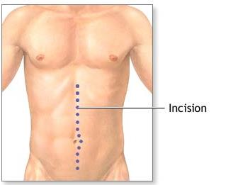
Procedure Data Fields: Open AAA
Exposure
Notes:
The exposure should be evident in the procedure note, but it will also be documented in the intra-procedure nursing notes.

Slide 32
Procedure Data Fields: Open AAA
Notes:
Next, we’re going to cover Distal Anastomosis, a data field pertaining to the location of the graft’s surgical connection.

Slide 33
Procedure Data Fields: Open AAA
Distal Anastomosis
Aorta
Common Iliac Artery
Notes:
As we learned, an open AAA repair, an incision is made into the aneurysm, the debris removed, clot and plaque, and a graft is sewn proximally and distally. The aneurysm sac is folded over the graft and left in place. The aneurysm sac is left in place because it will help to protect the graft and prevent adhesions.
Information on distal anastomosis can be found in the op note.

Slide 34
Procedure Data Fields: Open AAA
Distal Anastomosis
Aorta
Aorta-to aorta, or tube graft
Notes:
When the Distal Anastomosis is Aorta, that means the graft is placed within the aorta, like a tube.
As you can see in this image, surgical connection of the graft is below the renal arteries and above the iliac arteries, called an aorta-to-aorta graft or a tube graft

Slide 35
Procedure Data Fields: Open AAA
Distal Anastomosis
Common Iliac Artery
Bifurcated graft
Notes:
The other selection for Distal Anastomosis is Common Iliac Artery.
This picture shows Distal Anastomosis in the common iliac utilizing a bifurcated graft for aneurysms that have disease going into the iliac arteries.

Slide 36
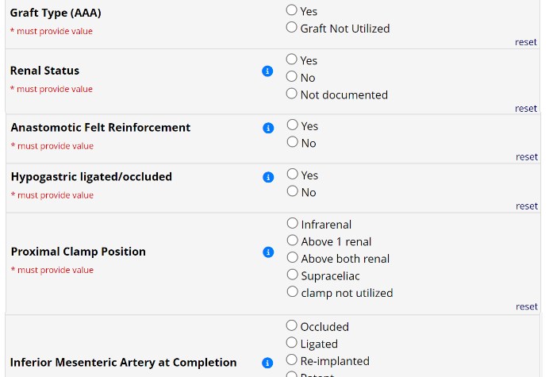
Procedure Data Fields: Open AAA
Notes:
Now let’s move on from Distal Anastomosis to renal status.

Slide 37
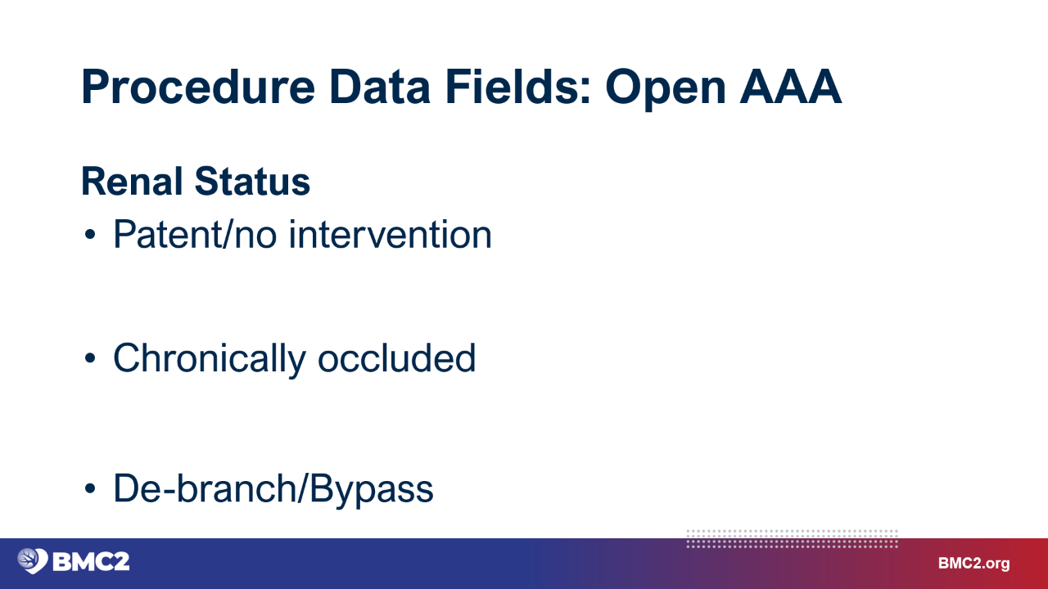
often in infrarenal repairs
patients with heavy thrombus burden or prior renal stenosis
additional surgery to create inflow for renal vessels
Notes:
Enter patent/no intervention if the renal arteries were patent pre-procedure and there was not any procedure done to maintain patency during the AAA repair.
Enter chronically occluded for patients with heavy thrombus burden or prior renal stenosis
Enter De-branch or renal bypass when the renal artery is bypassed and attached directly to the main body graft. Renal bypass is a rare event.

Slide 38
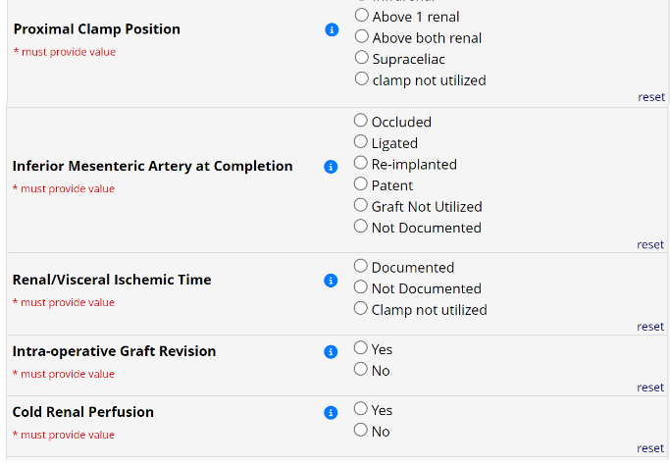
Procedure Data Fields: Open AAA
Notes:
Moving on from Renal Status, let’s learn about the Proximal Clamp position data variable.
To complete an open AAA repair procedure, the physician will need to clamp the aorta above the aneurysm to temporarily stop blood flow into the aorta while placing the graft, so it is important to capture the proximal clamping position for every open AAA procedure. Based on the location of the aneurysm, this proximal clamp position may be above one renal, above both renals or supraceliac.

Slide 39
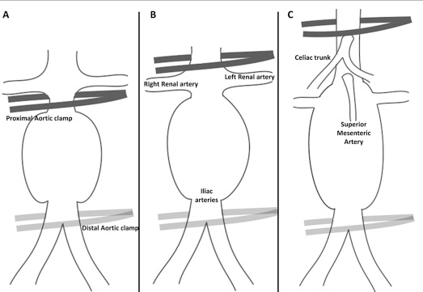
Procedure Data Fields: Open AAA
Proximal Clamp Position
Notes:
The clamp position options you will enter are infrarenal, above one renal, above both renals or supraceliac.
For patients cannot tolerate intubation, general anesthesia, or cross-clamping the aorta you will enter Unfit for Open AAA Repair in the Indications section.

Slide 40
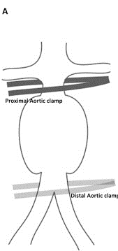
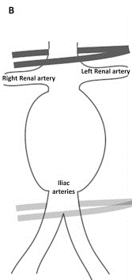
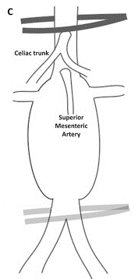
Procedure Data Fields: Open AAA
Proximal Clamp Position
Infrarenal (A)
Above 1 renal*
Above both renal (B)
Supraceliac (C)
*not shown
Notes:
The selection options for this data field are infrarenal, above one renal, above both renals or supraceliac.
For patients cannot tolerate intubation, general anesthesia, or cross-clamping the aorta you will enter Unfit for Open AAA Repair in the Indications section.

Slide 41
Procedure Data Fields: Open AAA

Slide 42
Procedure Data Fields: Open AAA
Renal/Visceral Ischemic Time
Notes:
If the proximal clamp is placed above any artery to vital organs, Renal/Visceral Ischemic Time must be entered into the BMC2 database. This data field documents how long one or both kidneys or bowel go without blood supply. This information is vital because ischemia time to kidneys or bowel can lead to kidney dysfunction, dialysis, bowel ischemia, bowel death, and patient death. This value can typically be found in the anesthesia narrative in a digital record, documented on a paper record, or in the surgeon’s notes.
If the proximal clamp position is Infrarenal, it is below the kidneys which means the renals had blood flow during the time the aorta was clamped; you would enter 0 minutes for ischemic time.
If the time is not documented, you can determine the length of time by subtracting the time the clamp was placed above 1 or both renals from the time the clamp was taken off.

Slide 43
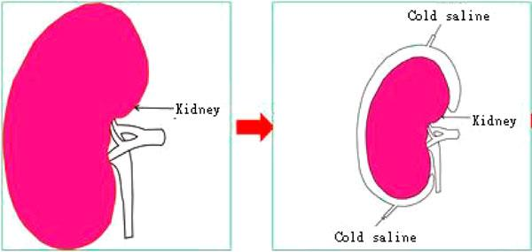

Procedure Data Fields: Open AAA
Cold Renal Perfusion
Notes:
If an open AAA requires cross-clamping the aorta above one or both renal arteries, the physician may choose to use a Cold Renal Perfusion , which is a cold saline via balloon tipped irrigation catheters into the renal artery orifices from within the opened aneurysm temporarily slow down kidney function and ideally prevent kidney damage.
The use of Cold Renal Perfusion would be clearly documented in the procedure note.

Slide 44
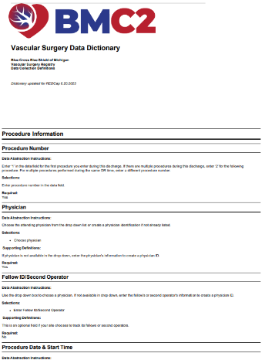
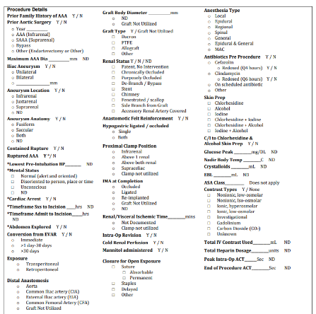
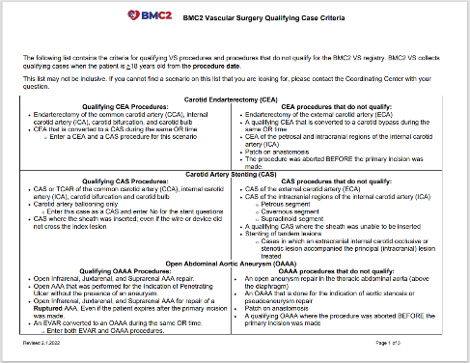
Procedure Data Fields: Open AAAA
Notes:
We’ve reached the conclusion of the Open AAA data fields training. Please proceed to the second half of the Abdominal Aortic Aneurysm repair module to learn about data abstraction for the EVAR procedure.

