Slide 1
BMC2 VS ABSTRACTION TRAINING
Labs Data Fields

Slide 2
Labs Pre Procedure

Slide 3
Labs Pre Procedure
You will enter Pre Procedure Labs for:
Open AAA
EVAR
Open Bypass
Open Thrombectomy
Carotid Artery Stenting
Carotid Endarterectomy
Notes:
The BMC2 vascular surgery registry collects pre-procedure labs for all 6 procedure types.

Slide 4
Labs Pre Procedure
The pre procedure labs we collect are:
Creatinine
Hemoglobin
BNP (Brain natriuretic peptide)
Troponin
Notes:
The pre-procedure labs we collect are listed here.

Slide 5
Pre Procedure Labs
For Pre Procedure Creatinine, Hgb, & BNP
Enter the last value documented within the 30 days before the current procedure.
If no value is documented, enter "Not drawn."
When multiple lab values are available pre-procedure, enter the value closest to the procedure start time.
Notes:
Enter the last lab value documented 30 days before the procedure for Pre Procedure Creatinine, Hgb, BNP and troponin. If no value is documented, enter "Not drawn."
When multiple lab values are available pre-procedure, enter the value closest to the procedure start time.

Slide 6
Pre Procedure Troponin
Enter the Troponin I, Troponin T, Troponin I HS (High Sensitivity) or Troponin T HS
Enter the Pre Procedure Troponin value and unit of the Troponin value
The reason you enter the unit of the Troponin value is that not every site uses the same unit of measurement for Troponins
Notes:
When entering pre-procedure troponin, you have 4 types of troponin to enter – Troponin I, T, I HS, or T HS. The HS stands for High Sensitivity. You will enter the pre-procedure troponin value and unit. You enter the unit of the Troponin value because not every site uses the same unit of measurement for Troponins.

Slide 7
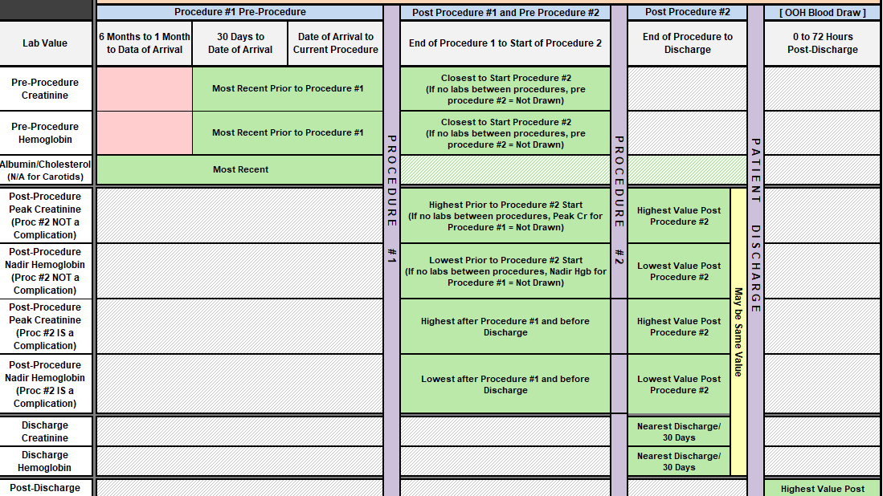
Notes:
If multiple procedures are performed within the same hospital encounter, enter the pre-procedure labs for the previous procedure before that procedure as you normally would.

Slide 8
Notes:
Enter the pre-procedure labs for the second procedure after the previous procedure and before the start of the 2nd procedure. If no labs are drawn from the end of the previous procedure to the start of the current procedure, enter "Not drawn."

Slide 9
Labs Post Procedure

Slide 10
Labs Post Procedure
You will enter Post Procedure Labs for:
Open AAA
EVAR
Open Bypass
Open Thrombectomy
Carotid Artery Stenting
Carotid Endarterectomy
Notes:
The BMC2 vascular surgery registry also collects post-procedure labs for all 6 procedure types.

Slide 11
Labs Post Procedure
The post procedure labs we collect are:
Peak Creatinine
Nadir Hemoglobin
Notes:
The post procedure labs we collect are Peak Creatinine and Nadir Hemoglobin. Nadir means the lowest value of hemoglobin documented.

Slide 12
Labs Post Procedure – Peak Creatinine
Enter the highest creatinine level recorded from the end of the procedure to the next procedure or discharge, whichever occurs first.
If there is no value drawn post procedure, mark "Not drawn.“
For extended hospitalizations, greater than 30 days, use the highest creatinine prior to day 30 after the procedure.

Slide 13
Labs Post Procedure – Nadir Hgb
Enter the lowest Hgb level recorded from the end of the procedure to the next procedure or discharge, whichever occurs first.
If there is no value drawn post procedure, mark "Not drawn.“

Slide 14
Caveat – Peak Creatinine & Nadir Hgb
If only one value is available post procedure through discharge, that value will be used for both the post procedure peak creatinine and the discharge creatinine.
Notes:
There is a caveat for both Peak post-procedure creatinine and nadir hemoglobin I would like to point out here. If only one value is available post procedure through discharge, that value will be used for both the post procedure value and the discharge value.

Slide 15
Post Procedure Labs – Multiple Procedures
Enter the highest creatinine value documented from the end of the procedure to the next procedure or discharge, whichever occurs first.
The next procedure is any procedure utilizing contrast, or any open surgical procedure.

Slide 16
Notes:
If the second procedure was not a complication of the 1st procedure, enter the nadir Hgb and peak Cr that is between the end of Procedure #1 and the start of Procedure #2 for Procedure #1.

Slide 17
Notes:
For Procedure #2 you would enter the nadir Hgb and peak Cr that is between the end of Procedure #2 and before discharge.

Slide 18
Notes:
If the 2nd procedure was a complication of the 1st procedure you would enter the nadir Hgb and peak Cr that is between the end of procedure #1 and before discharge for Procedure #1.

Slide 19
Notes:
For procedure #2 you would enter the nadir Hgb and peak Cr between the end of Procedure #2 and before discharge.

Slide 20
Labs - Other

Slide 21
Labs - Other
You will enter Labs in the Other category for
Open AAA
EVAR
Open Bypass
Open Thrombectomy

Slide 22
Labs - Other
The labs we collect in the Other category are:
Albumin
Enter the albumin value within 6 months before the current procedure. If no value is available pre-procedure, a value drawn during the current hospitalization may be used (if multiple values are available, enter the value closest to the procedure)
Notes:
Enter the albumin value within 6 months before the current procedure. If no value is available pre-procedure, a value drawn during the current hospitalization may be used (if multiple values are available, enter the value closest to the procedure)

Slide 23
Labs at Discharge

Slide 24
Labs at Discharge
Discharge Creatinine
Enter the value post-procedure and closest to discharge.
For extended hospitalizations, greater than 30 days, use the last
creatinine prior to day 30 after the procedure.
If a creatinine is not drawn post procedure and before discharge, enter not drawn.
If only one creatinine is drawn post procedure and before discharge, then that value would be used as the discharge creatinine and the post procedure peak creatinine value.
Post Discharge Creatinine
Enter the value 3-5 days after discharge
Discharge Hemoglobin
Enter the value closest to discharge
Notes:
Discharge Creatinine: Post procedure creatinine recorded closest to the time of discharge. For extended hospitalizations, greater than 30 days, use the last
creatinine prior to day 30 after the procedure. If a creatinine is not drawn post procedure, before discharge, then enter not drawn. If only one creatinine is drawn post procedure, before discharge, then that value would be used as the discharge creatinine and the post procedure peak creatinine value.
Post Discharge Creatinine: Record the highest Creatinine drawn within 3-5 days after discharge. If no labs are available in that timeframe, enter not drawn.
Discharge Hemoglobin: If a hemoglobin was not drawn post procedure, before discharge, then enter not drawn. If only one value is available post procedure,
before discharge, use that value for post procedure nadir hemoglobin and discharge hemoglobin.

