Slide 1
VS Site Coordinator Responsibilities & Expectations
Module II in the VS Site Coordinator Training
Part One: General Expectations
Notes:
This training is intended for new VS Site Coordinators or anyone one who feels they could use a refresher on this topic.
The Site Coordinator Responsibilities and Expectations module is broken down into two parts. This first part covers general expectations BMC2 has for all VS Site Coordinators, including, Data Abstraction, report distribution, and Meetings and trainings.

Slide 2
Key Partnerships and Their Roles
Physician Champions
Site Coordinators
Oversee site’s VS registry matters
Review all reports
Attend VS events
Provide clinical guidance to site’s VS team
Oversee data abstraction
Responsible for data submission, report distribution, quality improvement efforts
Coordinate VS efforts
Data abstractors
Participating Physicians
Review medical record
Responsible for accurate interpretation of definitions and data entry into VS registry
Participate but not responsible for VS registry matters
Notes:
Earlier, in the Introduction to BMC2 VS CQI module, you were given a very brief overview of the Site Coordinator role.
Now that you’ve had that introduction, this Site Coordinator Responsibilities training is going to go deeper, covering each of the responsibilities and the expectations BMC2 has for the person filling that role at your site.

Slide 3
Data Abstraction
Notes:
The first responsibility listed for a coordinator is overseeing their site’s data abstraction.
In the spring of 2023, BMC2 launched their new database, however given the requirement to input follow up patient data, Vascular Surgery data will still need to be entered into the previously used database in addition to the new REDCap database. Instructions for navigating to the correct database is detailed on the login landing page seen here.
Before we go into the expectations for data abstraction, let’s review the member login landing page.
________

Slide 4
Data Abstraction
Notes:
We learned previously data entered into the BMC2 database is gathered by the coordinating center and used by our programmers to create and distribute reports to our consortium sites, and these reports are a key component to the CQI model of quality improvement.

Slide 5
Data Abstraction
Responsibility: Oversee site’s data abstraction.
Accuracy
Consecutive case capture
Submitted on time
30-day & 1- year follow up
Notes:
As the site coordinator, you may not be the same person that is abstracting data from the patient charts but as a coordinator you are the person who ensures that the following criteria are met:
First, data must be abstracted accurately,
Second, all consecutive cases must be included
Third, all data must be submitted on time, and fourth, 30 day and 1 year follow up data is collected and entered for each discharge.

Slide 6
Data Abstraction
Notes:
The first of the four requirements is that the data collected by your site must be accurate.
Inaccurate data is not useful. The data abstracted from your patient records is the data that is used in your quarterly reports. It’s the data you see, and you present to your physicians, and it’s also the data that is used in comparison reports across the consortium. Accurate interpretation of the data definitions and accurate data entry is essential and as the site coordinator, it’s your responsibility to ensure our accuracy expectations are met.
Understanding the data definitions is essential in your role. Not only will need to be familiar with what the data definitions mean to ensure accuracy, but you will likely be the person who is asked when physicians or leadership wonder how those definitions are applied. If you have a question about how a definition is to be interpreted, please contact the coordinating center. We encourage you to ask as many questions as you need to in order to feel comfortable and confident in your role.

Slide 7
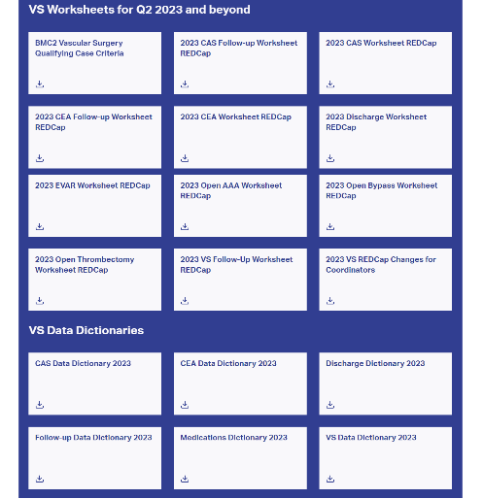
Data Abstraction Resources
Resources
Qualifying Case Criteria Document
OAAA & EVAR Worksheets
Data Dictionary
Notes:
These resources will assist you in accurate and efficient data abstraction. Let’s cover the basics.

Slide 8
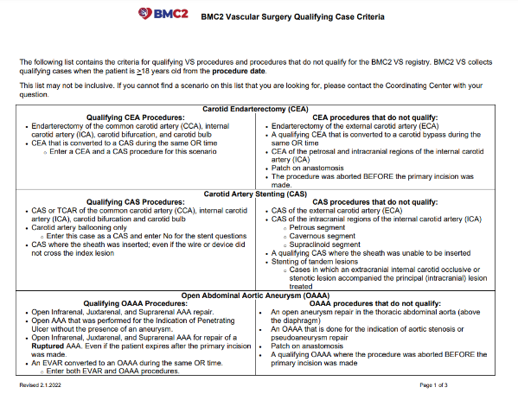
Data Abstraction Resources
Resources
Qualifying Case Criteria Document
OAAA & EVAR Worksheets
Data Dictionary
Notes:
The qualifying case criteria document provides information on which procedures meet criteria for including them in the BMC2 VS registry, and which cases do not meet criteria. This document can be used for all six of the Vascular Surgery procedures. Please download this document to your computer so you can refer to it when you are abstracting.

Slide 9
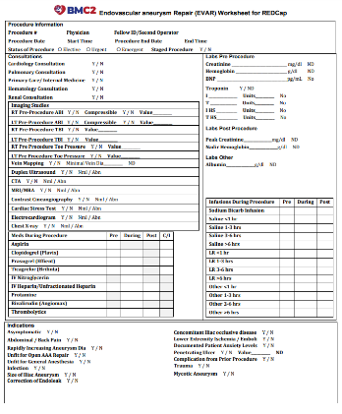
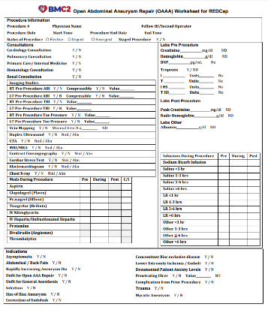
Data Abstraction Resources
Resources
Qualifying Case Criteria Document
OAAA & EVAR Worksheets
Data Dictionary
Notes:
You can abstract the details of the OAAA & EVAR procedures directly into REDCap. Or you can first abstract the data from your EMR onto the worksheets and then enter the worksheet data into REDCap.

Slide 10
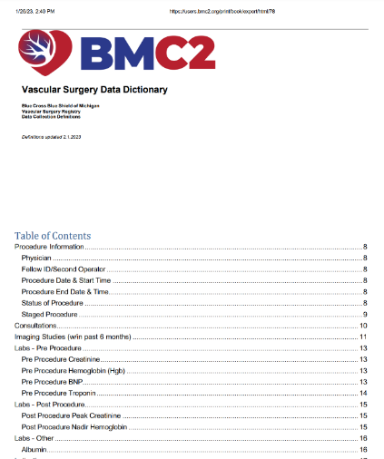
Data Abstraction Resources
Resources
Qualifying Case Criteria Document
OAAA & EVAR Worksheets
Data Dictionary
Notes:
The vascular surgery data dictionary is a document containing data variables for AAA repair procedures and Revascularization procedures, which are four of the six VS procedures. You’ll notice Carotid Procedures have their own dictionaries, but they are organized the same way as this one.
The data dictionaries are updated annually and are searchable using Ctrl+F.

Slide 11
Data Abstraction
Responsibility: Oversee site’s data abstraction.
Accuracy
Consecutive case capture
Submitted on time
30-day & 1- year follow up
Notes:
Just as important as accuracy, the second requirement is Consecutive Case Capture. Consecutive case capture doesn’t mean cases have to be entered in consecutive order, instead, it just means every case and attempted procedure from your site must be completely entered.
Again, as a Coordinator you may not be the person abstracting the data, but you are responsible for developing a system to ensure all VS cases are accounted for in the data registries. Now, consecutive case capture doesn’t mean cases have to be entered into the registries in consecutive order, however each VS case and attempted VS from your site must be completely entered.
Many find that creating a case log spreadsheet to be helpful, but you may need to familiarize yourself with how your site tracks cases so you can ensure consecutive case capture.

Slide 12
Data Abstraction
Notes:
To help you track all VS cases to ensure consecutive case capture, BMC2 has provided a VS Abstraction Spreadsheet template to help you track of patients and procedures at your site.

Slide 13
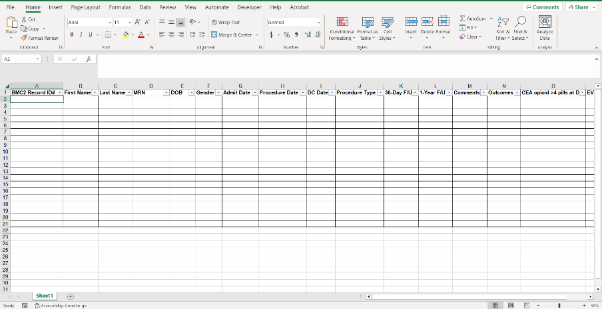
Data Abstraction
Notes:
This template is available for download in the coordinator resources section of the member resources tab. As you begin your role as a site coordinator, be sure to meet with your VS physician champion and your manager to determine what measures you need to track in real time. The file available is a downloadable excel template, so once you learn this site-specific information, you can customize the spreadsheet to meet your facility’s needs.

Slide 14
Data Abstraction
Responsibility: Oversee site’s data abstraction.
Accuracy
Consecutive case capture
Submitted on time
30-day & 1- year follow up
Notes:
The third criteria for the data abstraction responsibility is the on-time submission of your site’s data

Slide 15
Data Abstraction
Requirement –
Notes:
Site coordinators are responsible for submitting all cases by the registry’s deadlines. Data that is submitted after the data deadline will not be included in that quarter’s report, and you and your leadership will have until the next quarterly reports come out to receive an accurate report on performance. Additionally, timely data submission is tied to P4P.
A full listing of data entry deadlines are available on the BMC2 website.

Slide 16
Data Abstraction
Responsibility: Oversee site’s data abstraction.
Accuracy
Consecutive case capture
Submitted on time
30-day & 1- year follow up
Notes:
Finally, the fourth requirement is the submission of 30 day and 1 year follow up data for all vascular surgery discharges.
The 30-day follow-up information can be gathered anywhere from 2 weeks to 6 weeks post procedure, after the patient is discharged from the hospital.
If the patient is hospitalized greater than 30 days, get the follow up information from the first available appointment post discharge.
The 1-year follow-up information can be obtained from 9 to 14 months post procedure.
If a patient has a return appointment at 9 months, and at one year you do not see any other information, use the information you do have.
These time frames are guidelines.
Do not use the same information for more than one follow up. Best option is to have information in the Follow-up section of the website.
Follow-up forms are expected to be complete (form has data) for registry participation.
If you do not have follow-up information leave the follow-up section of the website blank. Do not enter “Not Documented” for every question.
Please enter partial follow-up information into the website.

Slide 17
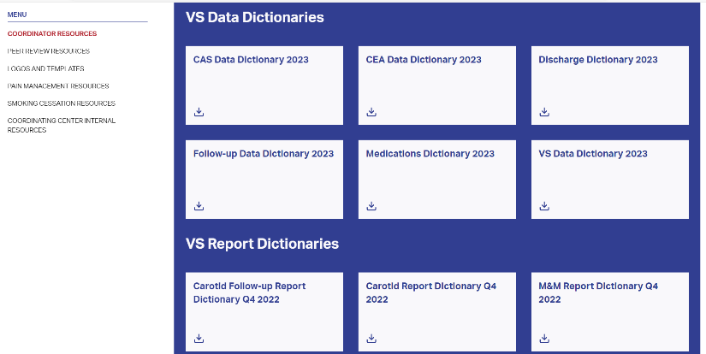
Data Abstraction
Notes:
The follow up data dictionary can be found in the member resources tab under coordinator resources, and it provides a thorough overview of collecting 30 day and 1 year follow-up outcomes, including procedure-specific data abstraction guidelines.

Slide 18
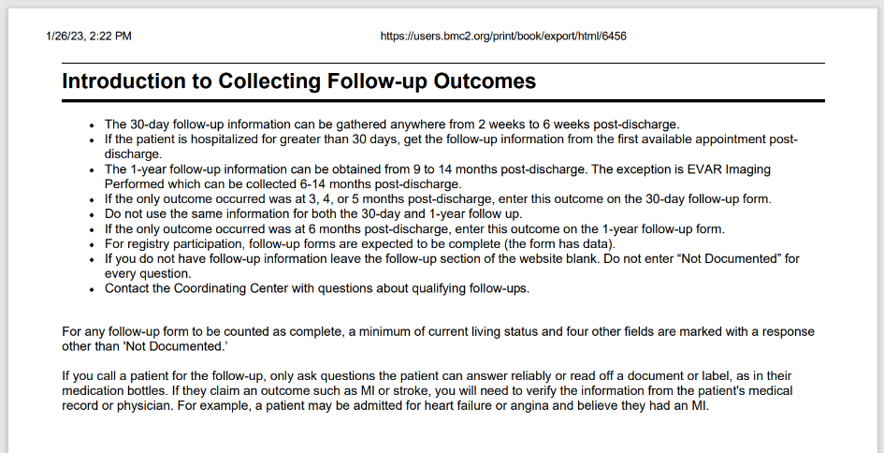
Data Abstraction

Slide 19
Report Distribution
Notes:
Currently, BMC2 distributes site level and physician level reports through its password protected website on a quarterly and year to date basis. In the Fall of 2023, BMC2 will be launching a new report distribution system which will email secure links to key individuals at consortium sites.
As the site coordinator, you will have access to reports through the BMC2 website and will be a recipient of the emailed reports links. You are responsible for determining the appropriate distribution protocol and ensuring these reports make their way to the key players at your site, including but not limited to, physician champions, quality improvement professionals, your leadership, and so on.

Slide 20
Meetings and Trainings
Overview –
One Annual Coordinator Meeting
One Collaborative Meeting (Coordinators & Physicians)
Monthly Coordinator check-in phone call
Notes:
Throughout the year, BMC2 will host a series of meetings and trainings for participants. These meetings are opportunities to learn new information, receive program updates and to network with other coordinators.
Those meetings consist of one annual coordinator meetings, one collaborative meeting, and monthly check-in phone calls.
Information on upcoming meetings can be found on the BMC2 website in the events section in the News and Events tab.
All BMC2 VS Sites are expected to participate in the meetings and trainings organized by BMC2. Specific meeting attendance requirements are communicated via the Performance Index Supporting documentation you will learn about in part 2 of this training.

Slide 21
VS Site Coordinator Responsibilities & Expectations
Module II in the VS Site Coordinator Training
Part Two: Coordinating BMC2 VS QI Efforts
Notes:
In the first part of this module, we covered the general responsibilities for site coordinators, such as expectations for data abstraction and information on distributing quarterly reports.
In this second segment, we are going to get into the substantial responsibilities VS coordinators have regarding the coordination of all VS quality improvement efforts at their site. In this segment, we’ll cover the annual performance index, coordinating and participating in annual site visits, and completing the peer review process.

Slide 22
Performance Index Management
Responsibility –
Coordination of efforts related to the annual Performance Index
Annual P4P Scorecard
P4P Supporting Documentation
Data Use/Quality Improvement
Notes:
As a site coordinator, you will be responsible for coordinating efforts related to the annual performance index.
There are three important components to explore when explaining the performance index. First, we’ll cover the P4P scorecard itself. Then We’ll go over the P4P supporting documentation, and finally we’ll learn about data use and quality improvement.
Let’s start with the p4p score card

Slide 23
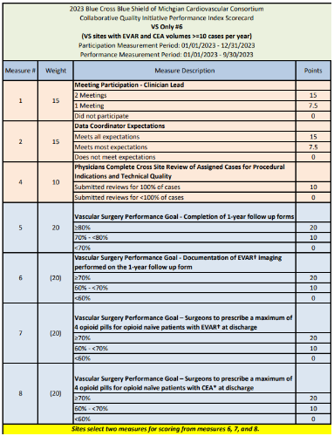
Annual P4P Scorecard
Updated annually
Performance determines P4P payment
Recognizes achievements and improvements
Both participation and Performance goals
Notes:
The P4P scorecard is the foundation of the performance index. This document is updated annually and is publicly available on the BMC2 website. The overall concept of the P4P scorecard is that a participating site’s scorecard performance determines their P4P payment. But this document also recognizes achievements and improvements and overall, is a major driver of quality improvement in patient care and safety. Each year’s scorecard measures include both participation points as well as key performance goals.
As a site coordinator you are responsible for staying knowledgeable and up to date on the annual P4P measures, and partnering with your site’s physician champion to communicate the relevant information to your team and maximize your site’s participation in BMC2 VS.

Slide 24
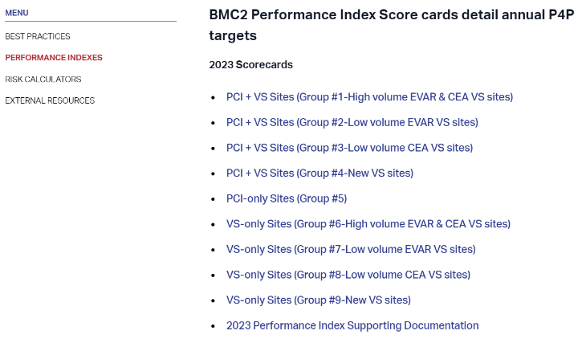
Annual P4P Scorecard
Notes:
Just as a reminder, the annual scorecard can be found in the Performance Indexes section of the Quality Improvement tab on the BMC2 website. Scorecards are customized based on sites’ procedural volume as well as participation in other BMC2 QI consortiums, however VS performance metrics are the same.

Slide 25
Performance Index Management
Responsibility –
Coordination of efforts related to the annual Performance Index
Annual P4P Scorecard
P4P Supporting Documentation
Data Use/Quality Improvement
Notes:
Moving on from the scorecard, let’s go over the supporting documentation available to you

Slide 26
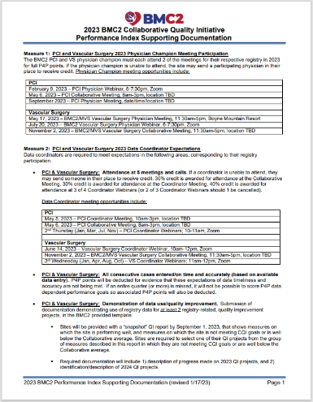
P4P Supporting Documentation
Explanation of each P4P measure
Meeting dates, requirements, and instructions
Numerator and denominator and exclusion criteria
Notes:
BMC2 has made available to you a support document packed with essential information on the current year’s scorecard.
This document includes
A detailed explanation and specific expectations for each measure
Important dates, requirements and detailed instructions for participation goals
As well as the numerator, denominator and exclusion criteria for the performance measures.
This level of detail is intended to answer your questions and empower you, the site coordinator, to become your site’s leading authority on requirements and expectations for full participation in BMC2’s VS P4P incentive.

Slide 27
Annual P4P Scorecard
Notes:
This supporting document can be found in the Performance index section of the Quality improvement tab below the annual scorecards

Slide 28
Performance Index Management
Responsibility –
Coordination of efforts related to the annual Performance Index
Annual P4P Scorecard
P4P Supporting Documentation
Data Use/Quality Improvement
Notes:
Now that we’ve covered the scorecard and it’s supporting documentation, let’s go over Data Use/Quality Improvement responsibilities

Slide 29
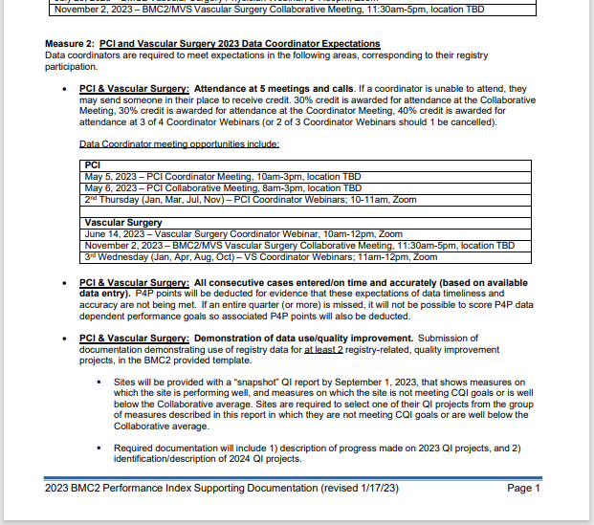
Notes:
Under measure two on the Performance Index supporting documentation, you’ll see find information on Data use and quality improvement
This process is an annual QI check-in between BMC2 and our consortium sites. This process allows for BMC2 to provide a bird's eye view of site’s strengths and opportunities for improvement, and it allows sites to create and implement their own unique project plans to target specific performance goals.

Slide 30
Data Use/Quality Improvement
Notes:
Every year, BMC2 initiates this process by providing sites with what we call a snapshot report.
The green sections are metrics where your site is performing very well. The yellow lines indicate where your site is falling below the consortium goal. Upon receiving your sites snapshot report, your site is expected to identify two registry related quality improvement projects. One of them must be from the yellow areas of your snapshot report.

Slide 31
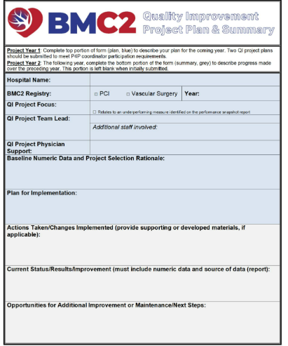
Data Use/Quality Improvement
Notes:
To assist you in developing those QI project plans, BMC2 has created the Quality Improvement Project Plan and Summary template. The first year of implementing your selected QI projects, you will complete only the top half. You will then return to this form the following year to complete the bottom half and describe the process you’ve initiated so far.

Slide 32
Data Use/Quality Improvement
Notes:
You can find the QI Project Plan Summary template on the BMC2 website under the Member Resources tab, in the coordinator resources section.

Slide 33
Site Visits
Overview –
Data audit for accuracy and case capture
Typically conducted annually
QI project review & learning opportunity
Rebecca Fleckenstein
VS Clinical QI Lead rflecke@med.umich.edu
Notes:
Site visits are a helpful tool for auditing and validating the accuracy and consecutive case capture at our sites.
They are typically conducted once a year
In addition to reviewing case data, annual site visits offer a chance to review annual QI projects and answer questions.
Visits are conducted by the VS Clinical QI Nurse Lead, Rebecca Fleckenstein
.

Slide 34
Site Visits
Opportunities –
Build Relationships
1:1 Site Support
Strategy development
Definition review & clarification
Notes:
Not only do site visits help promote accurate data collection, they also provide several valuable opportunities for both the coordinating center and the hosting site.
First off, a site visit is an opportunity to build relationships
Chance to learn the names and faces of key players at the coordinating center and at our sites. See your facility. To learn about your unit’s culture. In some cases, to meet site’s leadership and support buy-in.
Site visits are also an opportunity for 1:1 Site support
We at the coordinating center do see you as our partners in this important work, and our job is to support you be the best you can be. Site visits offer the opportunity for BMC2 to support our sites one on one, face to face.
Chance to engage in Strategy development
Opportunity for both the reviewer and the coordinator to share strategies for both QI and abstraction
Finally, it’s an opportunity for sites to review complex definitions or ask clarifying questions.
This is not a “data cleaning” exercise but serves as a learning opportunity as definitions are reviewed.

Slide 35
Site Visits
Coordinates EMR access for reviewer
BMC2 fully reviews & scores cases
Review findings & prepare documents
Manages Scheduling
Preparation
Notes:
PREPERATION
As a site coordinator, you will be responsible for preparing for your site visit and engaging with the reviewer the day of.
In preparation, Site coordinators are expected to :
Manage and coordinate the scheduling with your team and the BMC2 reviewer, typically 4-6 weeks ahead of time.
Site review lists with cases to be reviewed are emailed to the site coordinator well in advance of the site visit
Site coordinators are also responsible for Coordinating EMR access for the BMC2 reviewer
Communicates requirements for EMR access to BMC2 reviewer
Obtaining appropriate IT clearances
Once granted EMR access, the BMC2 reviewer will review selected cases against source documentation and EMR.
Errors will be scored as either as “Tier 1” which means key quality indicators, or “Tier 2” meaning all other data.
The reviewer will provide a report listing what was reviewed, the scores, any systematic errors, and needs for improvement.
Coordinators are responsible for reviewing the findings in this report, distributing it to appropriate team members, and preparing other documentation prior to the site visit.

Slide 36
Site Visits
BMC2 fully reviews & scores cases
Review findings & prepare documents
Manages Scheduling
Coordinates EMR access for reviewer
Preparation
BMC2 & Site team meeting
Coordinators make Tier 1 corrections
Day of Visit
Notes:
DAY OF VISIT
On the day of the visit, the BMC2 reviewer and the site’s team members will meet to discuss results of the audit, answer questions and talk strategy. The BMC2 reviewer will also go over the site’s data trends, QI projects and address any concerns.
Following that, Site coordinators will then be able to make data corrections to Tier 1 errors indicated in the reviewer report.

Slide 37
Peer Review
Overview –
Review of anonymized, de-identified cases
Provide feedback on Appropriateness of procedure
Different procedure every round
Up to two rounds each year
Notes:
Peer Review is an incredibly important component of quality improvement.
Each year Vascular Surgery sites engage in the cross-site peer review of anonymized, de-identified cases from physicians across the consortium. During the peer review process, physician reviewers provide feedback on the appropriateness of de-identified cases performed by their colleagues at sites across the consortium.
Different procedures are reviewed during each new round of peer review, and there may be up to two rounds of peer review per year depending on the QI needs of the consortium.
The feedback received from the reviews is used to guide QI activities with the goal of decreasing inappropriately performed procedures which can lead to decreased complications, decreased patient costs, decreased risk of readmission, and overall, improved clinical outcomes.

Slide 38
Peer Review
Process –
BMC2 randomly selects cases
Hospitals get a report on review
Coordinators upload the data
Physicians review and complete survey
Physicians get an email link
Notes:
The overall peer review process is this:
First, BMC2 randomly selects cases from a selected procedure for a site to include in their case upload.
Next, coordinators redact, de-identify, and upload case documentation for those selected cases
After documentation is uploaded, physician reviewers get an email link to access case documents
Physicians then will review each case and complete survey
Upon completion of the peer review, hospitals will receive a report on their results

Slide 39
Peer Review
Receive weekly status updates from BMC2
Follow up with reviewing physician as needed
Identify physician reviewer
Site Review
Notes:
For your site review, for your first responsibility is to identify and communicate to BMC2 who the physician reviewer is for the upcoming round at your site. This physician reviewer will be responsible for reviewing ten cases.
Once the peer review starts, BMC2 will provide the reviewing physician with access to case documentation to complete the reviews. BMC2 will provide the coordinator with a weekly update on the reviewer’s completion status. It is then the responsibility of the site coordinator to follow up with the reviewing physician to ensure 100% of reviews are submitted.

Slide 40
Peer Review
Receive weekly status updates from BMC2
Follow up with reviewing physician as needed
Identify physician reviewer
Site Review
Fully redact patient/site info from documents
Upload ALL case review materials
Obtain case list & review instructions
Case Upload
Notes:
For the case upload, the coordinator’s first responsibility is to obtain case list from the website and review specific instructions provided. Each round of peer review is different, and the required documents will vary.
Next, all documentation must be completely stripped and redacted of PHI and Hospital/site identification. Full and complete redaction will be necessary to receive all P4P points for this measure. Please note, coordinators may be expected to include cath films for selected cases, and obtaining cath films typically requires a separate, internal process which will need to be initiated well in advance of the upload deadline.
Finally, upload case review materials for 100% of the provided cases. No points will be awarded for <100%

Slide 41
Peer Review Participation
Notes:
Additional information on this year’s P4P measure for peer review can be found on the Performance Index Supporting documentation, as well as on the BMC2 website in the Peer Review Resources in the member Resources tab.

Slide 42
Please proceed to
Navigating the BMC2 Website

