Slide 1
BMC2 Carotid Procedures
Notes:
Please follow along with the CEA and CAS worksheets, the CEA and CAS data dictionaries, and the VS Qualifying Case Criteria document.

Slide 2
Carotid Artery Stenting (CAS) and
Carotid Endarterectomy (CEA)

Slide 3
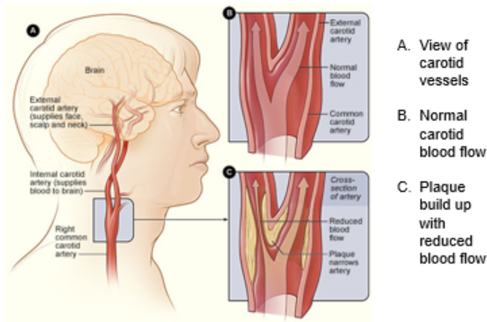
Carotid Anatomy
http://www.nhlbi.nih.gov/
Notes:
The anatomy of the carotid arteries includes the common carotid artery (CCA), the carotid bifurcation, internal carotid artery (ICA), external carotid artery (ECA), and the carotid bulb. The common carotid artery splits into the ICA and the ECA at the carotid bifurcation. The Carotid Bulb is located at the distal end of the internal carotid artery. The internal carotid artery supplies the brain with blood. The external carotid supplies blood to the face, neck and scalp. BMC2 VS collects carotid procedures involving the CCA, ICA, the carotid bifurcation and the carotid bulb.

Slide 4
Risk Factors
Hypertension – Most common!
Smoking
Hyperlipidemia
Diabetes
Obesity
Genetics
Sedentary lifestyle
Peripheral Arterial Disease (PAD) and Coronary Artery Disease (CAD) often precede carotid disease
Age/Sex
  Men under the age of 75 have a greater risk than women
  Women have a greater risk over the age of 75
Notes:
The risk factor for carotid artery disease are the same as for all our VS procedure types. Hypertension is the most common risk factor for patients who develop carotid artery disease. Most people have hyperlipidemia also. Most risk factors for carotid disease are modifiable risk factors.

Slide 5



Treatment
Treatment decision based on percentage of carotid stenosis, patient symptoms and risk factors
Carotid endarterectomy
Carotid stenting and angioplasty
Carotid bypass (currently not collected by BMC2)
Medical Management
  Antiplatelets
  Statins
  Antihypertensives
  Risk factor modification
  Weight loss Smoking cessation Increased physical activity
Notes:
Treatment for carotid artery disease includes surgical and nonsurgical interventions. Surgical options include carotid endarterectomy (CEA), carotid stenting (CAS) which includes angioplasty during the procedure and carotid bypass. Currently, VS collects CEA, CAS, and carotid ballooning procedures. We do not collect carotid bypass.
Medical management includes putting patients on statins, antiplatelets and/or antihypertensive and modifying risk factors such as weight loss, smoking cessation and increasing physical activity. Patients discharged with antiplatelets and statins after a CEA or CAS are two quality goals for BMC2 VS and guideline recommended care.

Slide 6
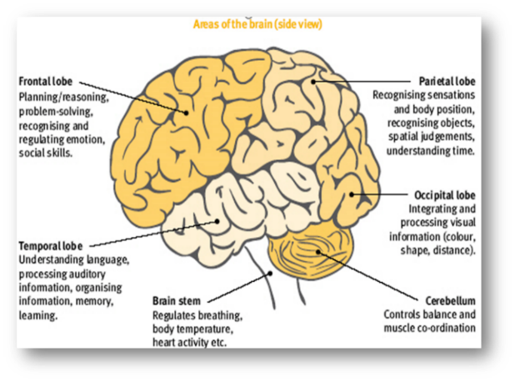
CAS/CEA Indication or Outcome: TIA or Stroke
TIA
  Focal neurologic abnormality of sudden onset and brief duration.
  Generally lasts <24 hours.
Stroke
  Neurologic abnormality leading to loss of function.
  Residual symptoms last > 24 hours.
https://www.quora.com/What-are-the-main-parts-of-the-brain-and-how-do-they-work
Notes:
A TIA or Stroke can affect any of the lobes of the brain. A TIA is defined as a neurological deficit or symptoms that lasts less than 24 hours. A Stroke is a deficit or symptoms that lasts greater than 24 hours. The VS data registry collects TIA and Stroke in both Neurological Event prior to the procedure and as an Outcome and asks for the area of involvement of the TIA or stroke. Strokes can be embolic, or ischemic, meaning that a piece of plaque, clot, or calcium broke off and traveled to the area where it is causing ischemia. These TIA and Ischemic Stroke areas are Retinal, Left or Right Hemispheric, or Vertebrobasilar.
A stroke can also be Hemorrhagic, or a bleed, and is classified as either Intraparenchymal, Subarachnoid or Subdural. The image above outlines the symptoms/deficits that may occur depending on the area of the brain impacted.

Slide 7
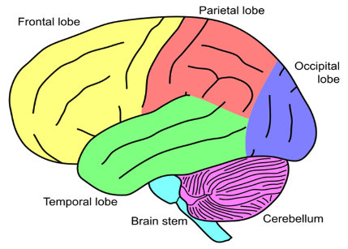
CAS/CEA Indication or Outcome: TIA or Stroke
Hemispheric: Frontal/Parietal/Occipital/Temporal Lobes
  Symptoms depend on the part of the brain that is affected
  Left Hemispheric stroke affects the right side of the body
  Right Hemispheric stroke affects the left side of the body
  Weakness or paralysis
  Speech difficulties
Notes:
A CT and/or an MRI will be ordered to determine the type and location of a stroke. A CT is typically ordered first and if the CT is not conclusive, an MRI may be ordered. Look to these diagnostic tests to determine the area of the stroke. The location may also be determined in the neuro consult note or the physician note, or the discharge summary. If you have any questions, please email Rebecca at rflecke@med.umich.edu for help in determining the location. Always include de-identified test reports or documentation that is discussing the event.

Slide 8

CAS/CEA Indication or Outcome: TIA or Stroke
Vertebrobasilar: Brain stem and Cerebellum
  Mortality rate of 85%
  Abnormal level of consciousness
  Weakness or paralysis (usually asymmetric)
  Facial weakness
  Ataxia
  Dysphonia
  Dysarthria
  Dysphagia
Notes:
Vertebrobasilar Strokes are rare but severe. The image shares the location impacted by a vertebrobasilar stroke and the associated deficits.

Slide 9
CAS/CEA Indication or Outcome: TIA or Stroke
Retinal
  Loss of peripheral vision
  Distorted/blurred vision
  Blind spots
Example of documentation
  Patient reports that he had right half of eye
  blindness that occurred during the week before
  cas, that is now a blurred area of the top half of
  the eye.
  Saw an ophthalmologist and had a standard arteriogram done that showed occluded proximal right internal carotid.
Documentation may include radiologic evidence of retinal artery occlusion
Notes:
Retinal Ischemia impacts vision. A Retinal TIA or Stroke can result in complete loss of vision in one eye, peripheral vision, blurred vision, or blind spots. Transient Monocular Blindness or amaurosis fugax is diagnosed when visual disturbance or loss (blindness, dimming, fogging, blurring) affects one eye for seconds or minutes.

Slide 10
CAS/CEA Indication or Outcome: TIA or Stroke
Intracranial Hemorrhage or Hemorrhagic Stroke
  Bursting or leaking of blood vessels in the brain
  May lead to impaired functional outcomes
Types of Hemorrhage or Hemorrhagic Stroke
  Intraparenchymal – within the brain tissue
    May occur in trauma or spontaneously with ICP
  Subarachnoid – between the brain and the meninges
    Usually caused by rupture of cerebral aneurysms
  Subdural – on surface of brain
    Usually caused by trauma, tumor or infection
Notes:
Hemorrhagic Strokes are uncommon. Bleeding from brain vessels puts pressure on the surrounding tissue potentially causing neuro deficits, either a TIA or Stroke. The VS registry collects Intracranial Hemorrhage or Intracranial Hemorrhagic Stroke as a Neurologic Event prior to procedure, or as an Outcome. A CT and/or an MRI will be ordered to determine the type and location of the bleed. A CT is typically ordered first and if the CT is not conclusive, an MRI may be ordered. Look to these diagnostic tests to determine the area of the bleed. The location may also be determined in the neuro consult note or the physician note, or the discharge summary.
Meninges = membranes that cover the brain

Slide 11
CAS/CEA Acute Evolving Stroke as an Indication
Ongoing and progressing at the time of the procedure. Acute evolving stroke includes all of the following:
Any sudden development of neurological deficits attributable to cerebral ischemia and/or infarction.
Onset of symptoms occurring within prior three days and ongoing at time of procedure.
The event is marked by progressively worsening symptoms.
Notes:
The BMC2 VS registry Acute Evolving Stroke documents if the patient is having ongoing symptoms at the time of the CEA or CAS procedure. Possible symptoms include, but are not limited to the following: numbness or weakness of the face or body; difficulty speaking or understanding; blurred or decreased vision; dizziness; or loss of balance and coordination.
Stroke as an Outcome would capture any new event or the worsening of a prior to procedure event. Worsening symptoms of a pre-procedure deficit would be marked as a new stroke post-procedure.

Slide 12
Carotid Duplex

Slide 13
Carotid Duplex
Impression:
The right carotid study reveals evidence of a 50-69% stenosis involving the ICA by velocities.
The left carotid study reveals evidence of a 70-99% stenosis involving the ICA by velocities.
History: Previous Left Stenosis. Previous Bilateral CEA.
Notes:
The Carotid Duplex Ultrasound is the gold standard for determining carotid stenosis. Carotid duplexes can be done in the physician’s office. If done in the physician’s office the results may not be in the patient’s EMR for the procedure. Without the diagnostic testing in the EMR, the procedure may be flagged for appropriateness. The coordinator needs to work to get pre-procedure testing into the EMR. The physician’s office may fax the testing to the Coordinator and the Coordinator can take the testing to Medical Records for it to be scanned into the EMR.
When determining the values for the Peak Systolic Velocity and End Diastolic Velocity, left or right, enter the highest value for the internal carotid artery. The ICA/CCA Ratios are typically at the bottom of the Carotid Duplex report.
All duplex reports look different at different sites. Take some time to familiarize yourself with your site’s reporting. If you have any question about which values to abstract, send a snip of the report, excluding all patient and physician identifiers to the BMC2 nurse auditor for help.

Slide 14
Carotid Duplex
When you have a patient with an occluded carotid and no values are available on the carotid duplex report, enter zero into the website for the measurements for PSV, EDV and the ratio.
Notes:
This duplex shows duplex results of a patient with an occluded right ICA.

Slide 15
Carotid Duplex
If both a proximal and a distal PSV and EDV are listed for the ICA. Take the site that has the highest systolic reading. Enter the velocity (both systolic and diastolic) from that site.
Notes:
Some Carotid Duplex Ultrasound reports further differentiate the stenosis by providing a proximal and distal reading for each artery. Follow the same rules, enter the highest value for the PSV and EDV for both the right and left carotid.
If a procedure is scheduled and started as a CEA, but converts to a carotid bypass once the artery is opened and evaluated, do not enter this case in the registry. It may happen that the physicians believed they could remove the stenosis by performing a CEA but some anatomical findings prove this impossible or not the best option for the patient. The BMC2 registry does not capture carotid bypass procedures. A bypass procedure would include an endarterectomy to remove plaque and cleaning the artery at either the origin or insertion. Because this is a typical part of a bypass procedure, we would not enter it as a separate CEA procedure.

Slide 16
Carotid Endarterectomy (CEA)

Slide 17
CEA Type of Procedure: Conventional
Longitudinal Arteriotomy after carotid is clamped
Shunting performed based on surgeon discretion and patient tolerance
  Monitor patient exam when awake
  Monitor EEG with general anesthesia
  Monitor stump pressures
  Higher risk of thrombus vs decreased perfusion to brain
Plaque dissected from inside of vessel
Back-bleeding of vessels to flush residual debris
Primary closure adequate for large carotid vessels
Patch closure is often used on small vessels, women and re-operative endarterectomies
  Aids in reducing recurrent stenosis
Notes:
The Type of Carotid Procedure for Carotid Endarterectomy can be Conventional or Eversion. The Conventional procedure involves making a longitudinal incision down the length of the artery. The artery is clamped proximal and distal to the incision. Plaque is dissected from the vessel. The vessel is irrigated and back bled to remove any debris that could cause an ischemic stroke. Closure may or may not include an Arteriotomy Patch.
A Conventional CEA can include an Eversion technique. Eversion is also the second way a CEA can be performed and will be discussed on a different slide. This Eversion technique done during a Conventional CEA is different. The Eversion technique involves plaque that is in the ICA and also going up into the ECA. The ICA plaque is removed through the Conventional arteriotomy incision and because plaque can also be seen to go up into the ECA. Disease does not conveniently start and stop. The plaque will be removed from the ECA by rolling back or everting the ECA and removing the plaque like turning a sock inside out.
“CEA requires temporary clamping of the carotid artery being worked on rendering the ipsilateral hemisphere dependent on collateral flow from the vertebral arteries and the contralateral carotid artery through the Circle of Willis. Neurologic monitoring is used to verify adequate perfusion of bilateral regions of the brain and to guide decision making in regards to shunting, BP control, and surgical technique. Also competing needs for increased BP vs. reducing myocardial workload, neurologic monitoring allows for aiming for lowest BP to maintain perfusion while reducing myocardial workload. Monitoring options include an awake patient under local anesthesia, EEG, SSEPs, and less often transcranial doppler(TCD), cerebral oximetry and stump pressures with reliability in that order.”₁₇
Carotid stump pressure estimates hemispheric blood flow by measuring pressure in the carotid stump distal to the clamp. Stump pressure is more often used to determine whether or not a shunt should be placed intraoperatively.
The BMC2 VS registry Monitoring During Procedure field specifies Awake, Stump Pressure and EEG. All other options will be abstracted as Other. Future website upgrades will break out more options including cerebral oximetry which is now captured under Other.

Slide 18
CEA Type of Procedure: Conventional
Image modified from http://med.umich.edu/1libr/Surgery/VascularSurgery/Illustrations/carotidEnd.wBloodFlow.pdf
Notes:
This image shows the steps involved in performing a Conventional CEA with an Arteriotomy Patch Used. A patch is used to prevent stenosis from the incision scarring down in narrower carotid arteries creating a different type of stenosis.

Slide 19
Arteriotomy Patch
1. Exposure and removal of plaque
2. Clean vessel prior to closure
3. Flushing residual debris
4. Completed patch closure
Notes:
These real life images also show the steps of a Conventional CEA procedure with an Arteriotomy Patch Used.

Slide 20
CEA Type of Procedure: Eversion
http://surgery.med.umich.edu/vascular/patient/pdf/carotideversion.pdf
Notes:
The second type of Carotid Procedure is an Eversion. An Eversion CEA is performed by transecting the carotid artery and using the Eversion technique to roll back or evert the artery and removed the plaque. Once the plaque is removed the artery is re-anastomosed end to end with a circumferential suture.

Slide 21
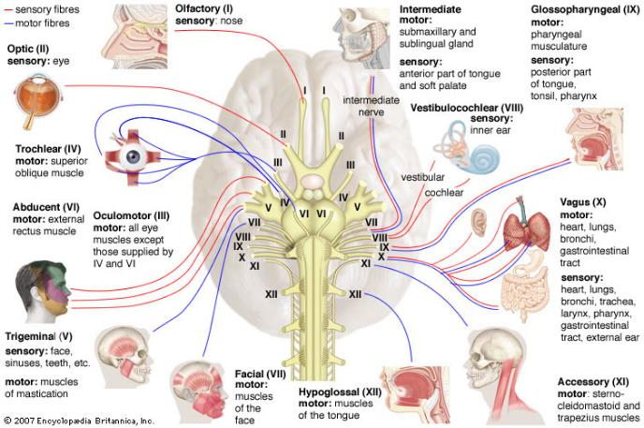
Cranial Nerve Areas of Innervation
https://www.britannica.com/science/nerve-anatomy
Notes:
The VS registry specifies Cranial Nerve Injuries VII, IX, X, and XII. Other is available for all other cranial nerve deficits.
Cranial Nerve VII injury sometimes called Bell’s palsy includes facial muscle paralysis.
Cranial Nerve IX injury includes deficits with swallowing and sensory and motor functions of the tongue.
Cranial Nerve X injury includes the heart, lungs, GI tract, sensory and motor functions.
Cranial Nerve XII injury includes tongue muscles and swallowing.

Slide 22
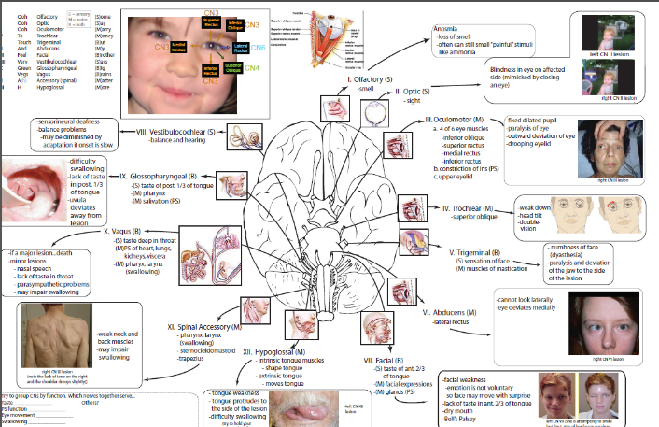
Cranial Nerve Injury (CNI)
https://neurohonors.wordpress.com/2013/05/01/hi/
Notes:
Another Cranial Nerve Injury reference outlining areas impacted.

Slide 23
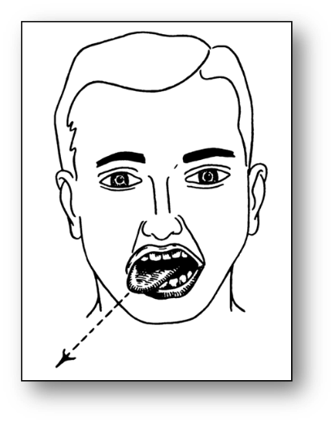
CEA Outcomes: CNI
Difficulty swallowing
Absent gag reflex
Hoarseness or weak voice
Tongue deviation
X/XII injuries are the most common
Documentation example:
Patient underwent right CEA. Post-op dictation states:
  “He had some initial difficulty with swallowing and facial activation along the mandibular branch of the facial nerve territory due to traction on the nerve in the OR but this resolved by post-operative day 2. Otherwise, his post-operative course was uncomplicated.”
https://teachmeanatomy.info/head/cranial-nerves/hypoglossal/
Notes:
Cranial Nerve Injuries can be challenging to interpret in the documentation. Any nerve deficit is not normal and should be claimed as an injury unless documented as the pre-procedure status.

Slide 24
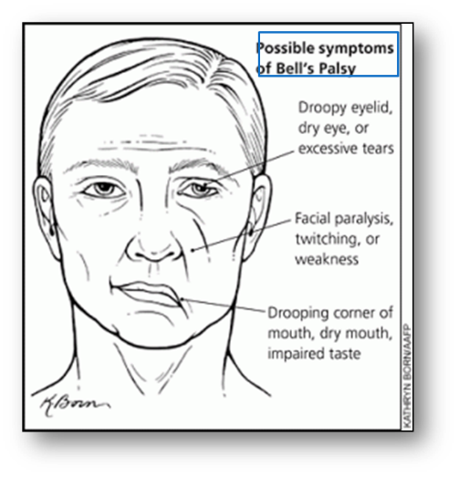
CEA Outcomes: CNI
Facial droop (usually at the eye
or corner of the mouth)
Dry mouth
Impaired taste
Documentation example:
  Nursing notes document new onset facial droop and smile asymmetry (not noted on any pre-procedure documentation)
  Not noted on progress note or discharge summary
  Accompanying nursing note states, “Physician shown patient’s smile and slight left droop. States that is ok.”
https://www.aafp.org/afp/2007/1001/p1004.html
Notes:
Here is another example of documentation that you may see about a CNI.

Slide 25
Carotid Artery Stenting (CAS)

Slide 26
Carotid Artery Stenting (CAS)
http://surgery.med.umich.edu/vascular/patient/pdf/Carotid_Stent.pdf
Notes:
Carotid Artery Stenting is a percutaneous procedure reserved for high risk carotid stenosis patients. The Procedural Arterial Access Site may be Femoral, Brachial, Radial, Axillary, Direct Carotid Puncture, or a Carotid Cutdown.
Direct Carotid Puncture is as suggested, the arterial access sheath is percutaneously placed directly into the carotid artery to avoid catheter manipulation around the aortic arch as in femoral access or used in patients with tortuous or diseased peripheral anatomy.
Carotid Cutdown is when there is a skin incision and dissection down to the artery and do a direct puncture into the artery with visualization.
The Stent Implanted can be Tapered. If Tapered, enter the smallest value for Stent Diameter. Predilation Prior to Attempted Stent Implant is common. Ballooning/Post Dilation Performed after stent deployment is also common. See next slide for discussion about Embolic Protection and Predilation Prior to Embolic Protection Device Deployment which is uncommon.

Slide 27
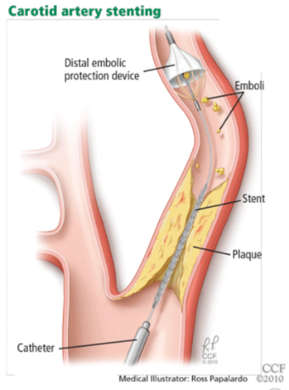
Embolic Protection
Notes:
Embolic Protection Attempted is the field available to capture the device used to catch debris that could go into the cranial vessels and cause a TIA or Stroke. The embolic device can be a filter like the one shown or a balloon occlusion device.
CMS has mandated that all CAS procedures use Embolic Protection. There are some CAS procedures where the anatomy does not allow for an Embolic Protection Device to be used. It is very uncommon to have Predilation Prior to Embolic Protection Device Deployment because ballooning the stenosis may break off debris that can cause an ischemic event. Ballooning or Post Dilation Performed is very common, after stent placement. Typically the procedure is access, embolic protection, ballooning, stent, post ballooning to ensure stent approximation to the arterial wall, remove embolic protection, remove vascular access.
The VS CAS registry also captures Carotid Artery Ballooning alone. Ballooning without placing a stent is not common. If you have a Carotid Artery Ballooning only case, answer No to Stent Implanted and the fields of Stent Tapered, Stent Diameter, Stent Length, Stent Manufacturer and Stent Model Name will not open.
The embolic device can be a filter like the one shown here or a balloon occlusion device. The carotid stent can be tapered. Enter the smallest stent diameter for stenosis. For CAS procedures we do capture cases where they do a balloon angio only for carotid stenosis. You would enter CAS then enter No for Stent and enter Yes for the Embolic protection and balloon fields.

Slide 28
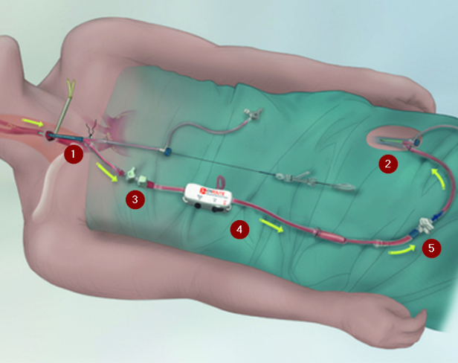
TCAR: Flow Reversal
The surgeon inserts a sheath into the carotid artery.
The sheath is connected to a catheter in the femoral vein.
The pressure difference reverses blood flow away from the brain and into the catheter.
The blood passes through a filter, which traps any plaque or debris.
The clean blood then flows back into the patient, minimizing blood loss.
Notes:
TransCarotid Artery Revascularization, (TCAR), is a type of CAS. TCAR is a flow reversal technique used to prevent emboli from accessing the brain vasculature. The procedure utilizes direct carotid access and femoral venous access. The lower pressure in the femoral vein creates a pressure gradient which reverses blood flow toward the femoral vein where the blood is filtered to remove any debris. Please Google Silk Road Medical for more TCAR information at https://silkroadmed.com/the-tcar-procedure/.

Slide 29
CAS Anatomic Variables
Fibromuscular Dysplasia of Carotid Artery (FMD)
  Stenosis caused by an excess of fibrous or muscular
  components of the arterial wall
  Often asymptomatic, discovered as an incidental finding
  Most common in women age 40-60 according to Cleveland Clinic
Aortic Arch Type I, II, III
Bovine Arch
Lesion Location
  High Cervical – An ICA lesion high in the neck, at or near C2
  Low Intrathoracic – A CCA lesion at or below the level of the clavicle
Notes:
Fibromuscular Dysplasia of Carotid Artery, or FMD, is a non-atherosclerotic disease which causes Carotid stenosis. FMD has a beaded appearance on fluoro.
The field of Lesion Difficult to Access Surgically is available to lend appropriateness to carotid artery stent procedures that would not be able to be reached through a typical incision but are not high risk to warrant a CAS procedure otherwise. High Cervical and Low Intrathoracic are options available.

Slide 30
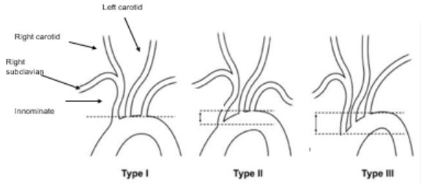
Aortic Arch Types
Type I: All three vessels originate in the same horizontal plane as the outer curvature of the aortic arch
Type II: The innominate artery originates between the horizontal planes
of the inner and outer curvature of the aortic arch
Type III: The innominate artery originates below the horizontal plane
of the inner curvature of the aortic arch
Notes:
The Aortic Arch Type is a technical aspect of the CAS procedure that determines the difficulty of accessing the carotid arteries. Cerebral embolism and increased fluoro time and contrast volumes can all be associated with Type II and Type III arch types due to increased angle of insertion for wire/catheter.
The vertical distance from the origin of the innominate artery to the top of the arch determines the arch type. This distance is < 1 diameter of the left common carotid artery (CCA) in a Type I arch, between 1 and 2 CCA diameters in a Type II arch, and > 2 CCA diameters in a Type III arch.

Slide 31
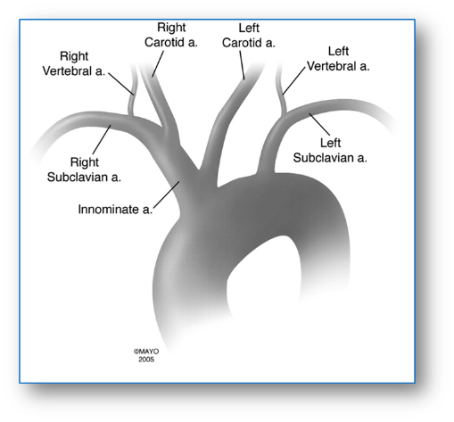
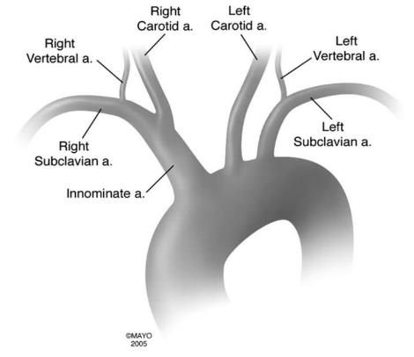
Normal vs Bovine Aortic Arch
Bovine Aortic Arch
Normal Aortic Arch
Notes:
Bovine Arch is the most common anatomic variant of the human aortic arch.
The left image is a normal aortic arch where the innominate artery originates from the aortic arch and the right carotid artery branches off of the innominate artery. The left carotid artery has an independent origin from the aortic arch.
The right image is a Bovine Arch, where both the right and left carotid arteries originate from the innominate artery.
Bovine Arch has been associated with increased risk of technical failure and cerebral embolization during left internal carotid artery stenting.

Slide 32
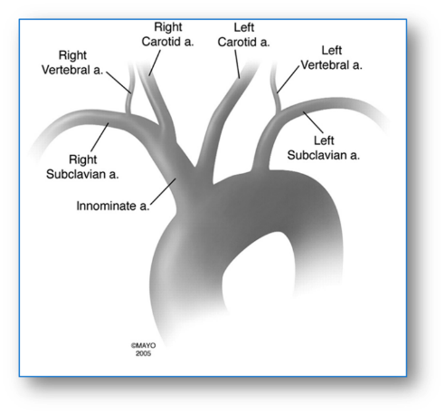
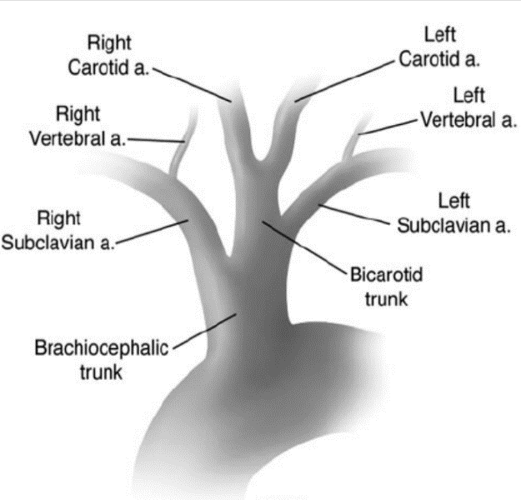
Bovine Aortic Arch
Cow
Human
Notes:
This is a comparison of the anatomy of a Human Bovine Arch and a Cow Bovine Arch. The similarities are slight.

Slide 33
CEA/CAS Outcomes

Slide 34
CEA/CAS: Outcomes
New Stroke or TIA (CEA/CAS)
Vascular access complications
Filter spasm
Slow flow
Notes:
Outcomes of CAS and CEA procedures are not common. The CAS Outcomes are Stroke and TIA outcomes have been discussed prior with history and indications. CEA and CAS Outcomes cover both in lab/OR and post-procedure
Vascular Access Complications are a potential for any percutaneous procedure.
Retroperitoneal Hematoma is diagnosed on CT.
Pseudoaneurysm is found with duplex ultrasound and may or may not require a repair.
Bleeding and Hematoma at the site is the most common access complication. Both will require additional pressure/holding of the access site.
AV Fistula may require an injection in IR to repair the fistula.
Surgical Repair of the Vascular Access Site may be used for any of the above Vascular Access Complications.
The field utilizes checkboxes, so multiple options may be chosen. However, if the access site starts with bleeding, increases to a hematoma, and then CT confirms a retroperitoneal hematoma, do not claim all three outcomes, choose the most severe, Retroperitoneal Hematoma.
Filter Spasm after the placement of an Embolic Protection Device can cause vasospasm which may lead to a decrease in cerebral blood flow.
Slow Flow is defined as a significant reduction in antegrade flow in the ICA proximal to the filter device thought to be caused by debris in the filter.

Slide 35
References
American College of Cardiology. (2013). Carotid Endarterectomy for TIA and Stroke. Retrieved November 21, 2019. https://www.cardiosmart.org/Healthwise/hw22/4563/hw224563
Born, Kathryn. (2007, October 1). Possible Symptoms of Bell’s Palsy. [Online image]. Retrieved from https://www.aafp.org/afp/2007/1001/p1004.html
Broder, J., and Preston, R. (2011). Intraparenchymal Hemorrhage. Retrieved February 26, 2020 from https://www.sciencedirect.com/topics/neuroscience/intraparenchymal-hemorrhage
Casserly, I.P., Abou-Chebl, A., Fathi, R.B., Lee, D.S., Saw, J., Exaire, J.E., … Yadav, J.S. (October 18, 2005). Slow Flow Phenomenon During Carotid Artery Intervention With Embolic Protection Devices: Predictors and Clinical Outcome. Journal of the American College of Cardiology, 46(8), 1466-1472. Retrieved from https://www.sciencedirect.com/science/article/pii/S0735109705017237?via%3Dihub#
Cranial Nerves for the SLP (2013, May 1). [Online image]. Retrieved December 3, 2019 from https://neurohonors.wordpress.com/2013/05/01/hi/

Slide 36
References
The cranial nerves (I-XII) and their areas of innervation. [Online image]. Retrieved November 21, 2019 from https://www.britannica.com/science/nerve-anatomy
Farooq, M.U., Goshgarian, C., Min, J. and Gorelick, P.B. (06 September 2016). Pathophysiology and management of reperfusion injury and hyperperfusion syndrome after carotid endarterectomy and carotid artery stenting. Experimental & Translational Stroke Medicine, 8(7). Retrieved from https://doi.org/10.1186/s13231-016-0021-2
Gaciong, Z., Sinski, M., and Lewandowski, J. (2103). Blood Pressure Control and Primary Prevention of Stroke: Summary of the Recent Clinical Trial Data and Meta-Analyses. Current Hypertension Reports, 15(6), 559-574. doi:10.1007%2Fs11906-013-0401-0
The Internet Stroke Center. (n.d.). Subarachnoid Hemorrhage. Retrieved February 26, 2020 from http://www.strokecenter.org/patients/about-stroke/subarachnoid-hemorrhage/
Layton, K.F., Kallmes, D.F., Cloft, E.P., and Cox, V.S. (2006, August). Bovine Aortic Arch Variant in Humans: Clarification of a Common Misnomer. American Journal of Neuroradiology, 2(7), 1541-1542. [Figures 1, 2, and 3]. Retrieved from http://www.ajnr.org/content/27/7/1541.full

Slide 37
References
Lee, K.B., Lee, K.H., Chung, C.S., Kim, G.M., Byun, H.S., Jeon, P., … Kim, Y.W. (2009). Carotid Endarterectomy: Analysis of Early Complications (<30 days) and Risk Factors for Postoperative New Brain Infarction. Journal of Korean Surgical Society, 77(3). [Figure 1]. Retrieved from https://www.semanticscholar.org/paper/Carotid-Endarterectomy%3A-Analysis-of-Early-(%3C30-and-Lee-Lee/b1145d2868e6b18264356de723a4d1e582c87e45/figure/0
Madwahl, S., Rajagopal, V., Bhatt, D.L., Bajzer, C.T., Whitlow, P., Kapadia, S.R. (2008, May). Predictors of Difficult Carotid Stenting as Determined by Aortic Arch Angiography. Journal of Invasive Cardiology, 20(5). [Fig. 2]. Retrieved from http://www.invasivecardiology.,com/article/8754
Michigan Medicine. (2010, June). Carotid Artery Stenting. Retrieved November 22, 2019 from http://surgery.med.umich.edu/vascular/patient/pdf/Carotid_Stent.pdf
Michigan Medicine. (2010, June). Carotid Endarterectomy Eversion Technique – Surgery. Retrieved November 21, 2019 from http://surgery.med.umich.edu/vascular/patient/pdf/carotideversion.pdf
Michigan Medicine. (2016, May). Carotid Endarterectomy: Normal Blood Flow to the Brain. Retrieved November 21, 2019 from http://med.umich.edu/1libr/Surgery/VascularSurgery/Illustrations/carotidEnd.wBloodFlow.pdf

Slide 38
References
National Institutes of Health, National Heart, Lung, and Blood Institute (n.d.). Carotid Artery Disease. Retrieved November 6, 2019 from https://www.nhlbi.nih.gov/health-topics/carotid-artery-disease
Open Anesthesia, Carotid Endarterectomy: CNS Monitoring (n.d.). Retrieved May 15, 2020 from
https://www.openanesthesia.org/carotid_endarterectomy_cns_monitoring/
Petitjean, C. (n.d.). Carotid.net General Public Area. Retrieved November 21, 2019 from http://carotid.net/public_area/
Plummer, D., and Neville, R.F. (2009). Patch Angioplasty. (Figure 58-10). Retrieved from https://www.sciencedirect.com/topics/medicine-and-dentistry/patch-angioplasty
Patel, R.A.G. (2014). State of the Art in Carotid Artery Stenting: Trial Data, Technical Aspects, and Limitations. Journal of Cardiovascular Translational Research, 7(4), 446-457, [Fig. 2]. Retrieved from https://link.springer.com/article/10.1007%2Fs12265-014-9567-3

Slide 39
References
Quora. (2017, May 24). What are the main parts of the brain and how do they work? Retrieved November 22, 2019 from https://www.quora.com/What-are-the-main-parts-of-the-brain-and-how-do-they-work
Rasmussen, T.E., Clouse, W.D., & Tonnessen, B.H. (2019). Handbook of Patient Care in Vascular Diseases (6th ed.). Philadelphia: Wolters Kluwer.
Right hypoglossal nerve palsy, characterized by deviation of the tongue to the right. [Online image]. (n.d.). Retrieved on November 22, 2019 from https://teachmeanatomy.info/head/cranial-nerves/hypoglossal/
Rothwell, P.M., Algra, A., Chen, Z., Diener, H.C., Norrving, B., DPhil, Z.M. (2016, July 23-29). Effects of aspirin on risk and severity of early recurrent stroke after transient ischaemic attack and ischaemic stroke: time-course analysis of randomised trials. The Lancet, 388(10042), 365-375. Retrieved from doi:10.1016/S0140-6736(16)30468-8
Vascular News. (2015. November 3). Silk Road Medical enrolls first patient in ROADSTER 2 trial. Retrieved November 22, 2019 from https://vascularnews.com/silk-road-medical-enrols-first-patient-in-roadster-2-trial/

Slide 40
References
Vega, J. (n.d.). What to Know About Subdural Hemorrhages. Retrieved February 26, 2020 from https://www.verywellhealth.com/what-is-a-subdural-hemorrhage-3146102
Zhao, J., Zhang, X., Dong, L., Wen, Y., Cui, L. (2014). The Many Roles of Statins in Ischemic Stroke. Current Neuropharmacology, 12(6). doi:10.2174%2F1570159X12666140923210929

